Slide 1
A Systematic Survey of Just-In-Time Software Defect Prediction
Second Exam Presentation
Yunhua Zhao
Advisor: Prof.Hui Chen
Notes:
1h presentation, may skip slides, page number, could be stopped, discussion, give chance

Slide 2




Background
Software Quality is important | Examples from companies
Software quality is very important:
Influence customer loyalty, brand reputation, and profitability
Cause critical problems in specific industry area
In 2016, the global software failure cost crossed $1.1 trillion because of software bugs.
These failures were reported by 363 companies and affected almost 4.4 billion consumers.
Majority of these incidents could have been avoided, but the software passed onto the customers without proper quality assurance.

Slide 3



Background
Examples from companies | Findings from IBM
NASA launched the Mars Climate Orbiter in 1998, which got lost into space and the communication got cut-off.
The $125 million spacecraft revolved very close to Mars’ surface and broke due to the engineering team failure to transform their measurements from U.S. units to metric
AT&T failed to meet the rudimentary requirements of their consumers in January 1990. It totally lost 200,000 lost airline reservations and 75 million missed phone calls.
one-liner buggy code caused a loss to AT&T of about $60 million.
Knight Capital Group released a new trading software to help them on the stock markets in 2012. Several software errors combined to send Knight on a crazy buying spree, spending more than $7 billion on 150 different stocks.
The unintended trades ended up costing the company $440 million.
https://www.kualitee.com/bug-management/3-cases-where-software-bugs-deteriorated-companys-profile/

Slide 4
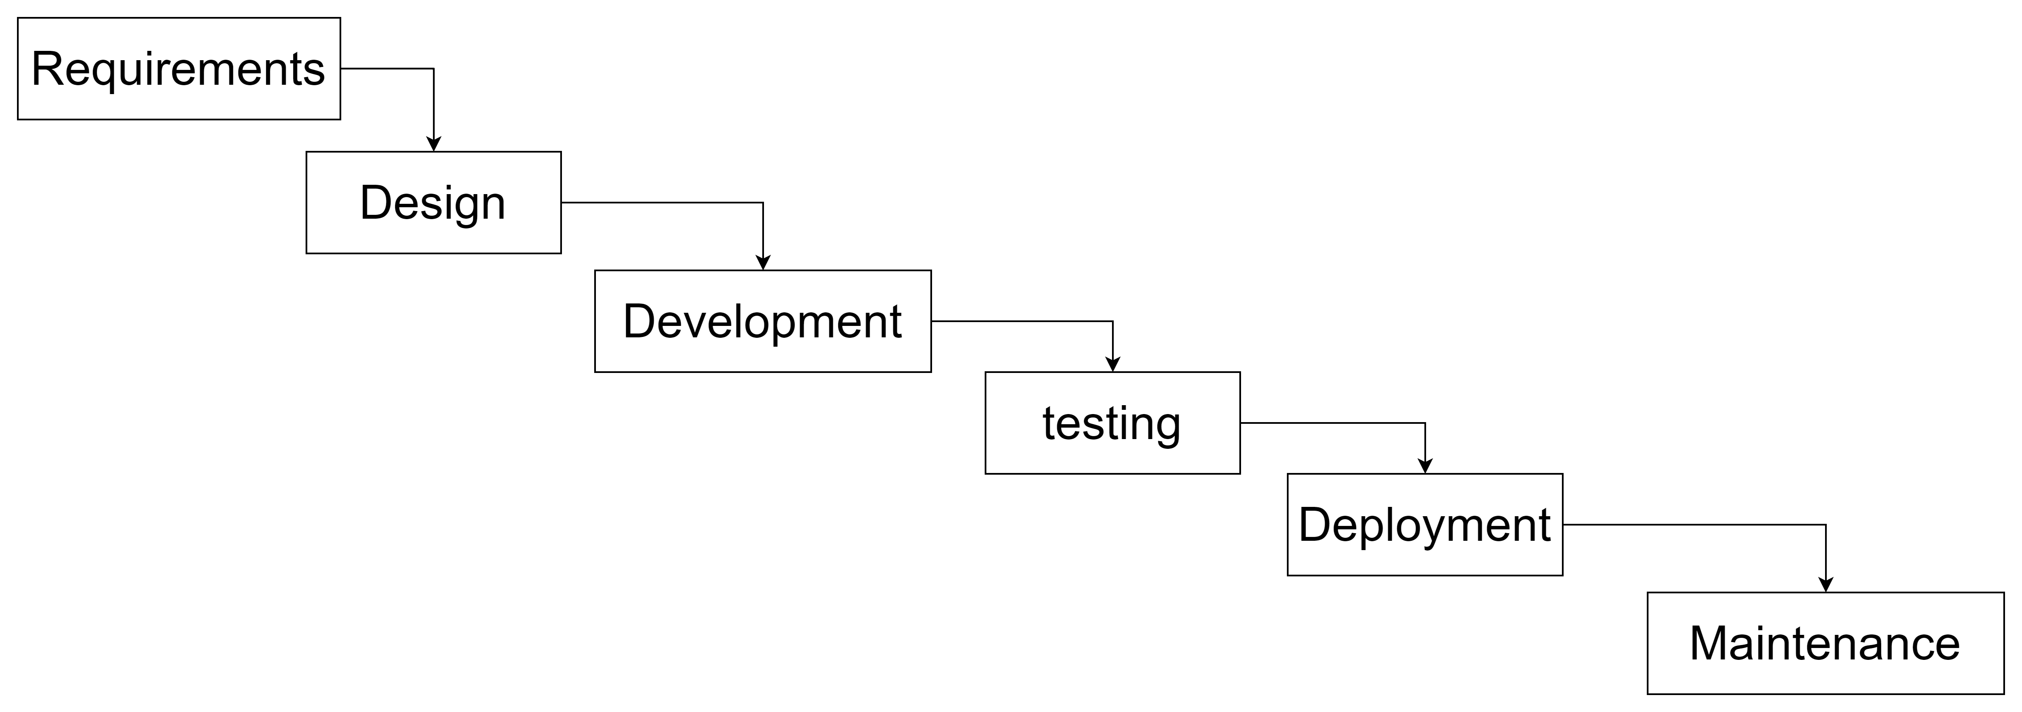
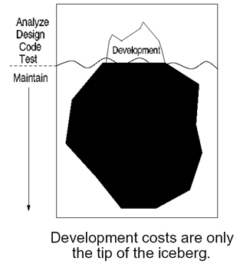
Background
Findings from IBM | Motivation
IBM found out that:
the cost goes up as the bug passes by the software development lifecycle.
The cost of fixing the errors after the release is four to five times more than if it is detected during the designing phase.
It becomes a hundred times more expensive when the errors are identified during the maintenance phase.
2) the software bug expenses also cause the loss of an average $2.3 billion of shareholder value on the very first day.
https://www.kualitee.com/bug-management/3-cases-where-software-bugs-deteriorated-companys-profile/

Slide 5
Motivation
Motivation | Summary
Companies trying to outdo each other, software fast releasing and updating Cause software defects in released products, which leads to:
Expensive consequences
Affect company reputation
Goal: Detect more defects before software releasing
Software Quality Assurance plays an important role in producing high quality software.
Software Defect Prediction (SDP) aims to predict the likelihood of defects in software artifacts, typically, in source code elements of different granularity (e.g., methods, classes, files, components).
SDP for prioritizing maintenance tasks, planning activities to reduce technical debt, estimating cost and needed resources for project Quality Assurance (QA) efforts

Slide 6
Summary
Summary | Overview
Just-in-Time Software Defect Prediction (JIT-SDP) aims to predict the defect likelihood of each software change and to be an earlier step of continuous quality control because it can be invoked as soon as a developer commits code to their private or to the team’s workspace.
Predictions are made at a fine granularity: Predictions identify defect-inducing changes which are mapped to small areas of the code and provide large effort savings over coarser grained predictions
Predictions can be expressed as concrete work assignments for a developer to fix a defect due to a change: Changes can be easily mapped to the person who committed the change. This can save time in finding the developer who introduced the defect (if a defect is induced) because the person who made the change is most familiar with it.
Predictions are made early on: Only change properties are used for predictions. Therefore, the prediction can be performed at the time when the change is submitted for unit test (private view) or integration. Such immediate feedback ensures that the design decisions are still fresh in the minds of developers.

Slide 7
Overview
Overview | Paper Selection
Introduction
Paper Selection and Publication Trend
Publication Trend
Overview of JIT-SDP
Review of Just-in-time Software Defect Prediction
Data Sources
Feature Acquisition and Processing
Defect-Inducing Label Assignment
Data Transformation
Modeling
Evaluation
Analysis and Open Questions
Future Research
Conclusion

Slide 8
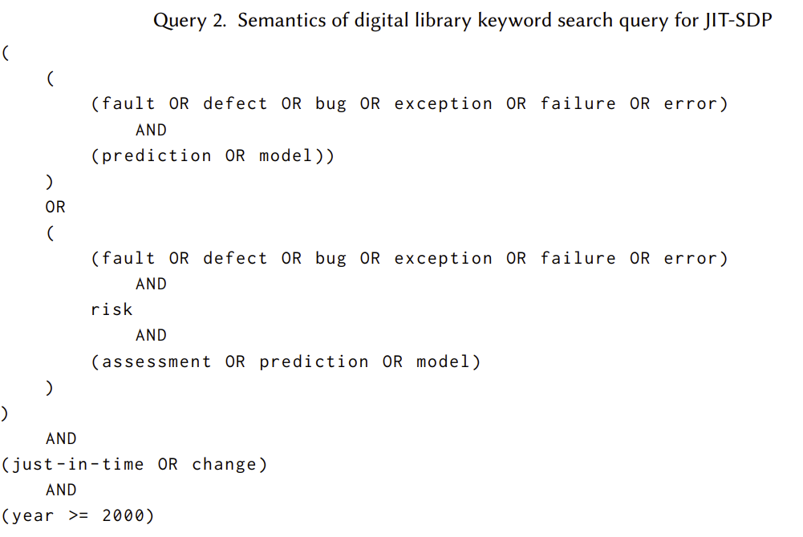
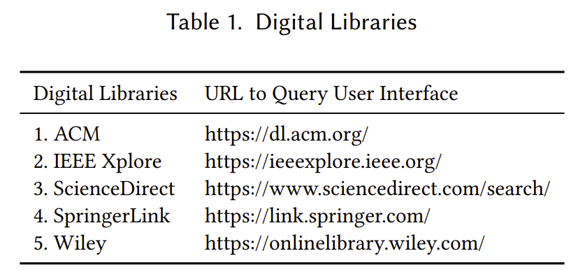
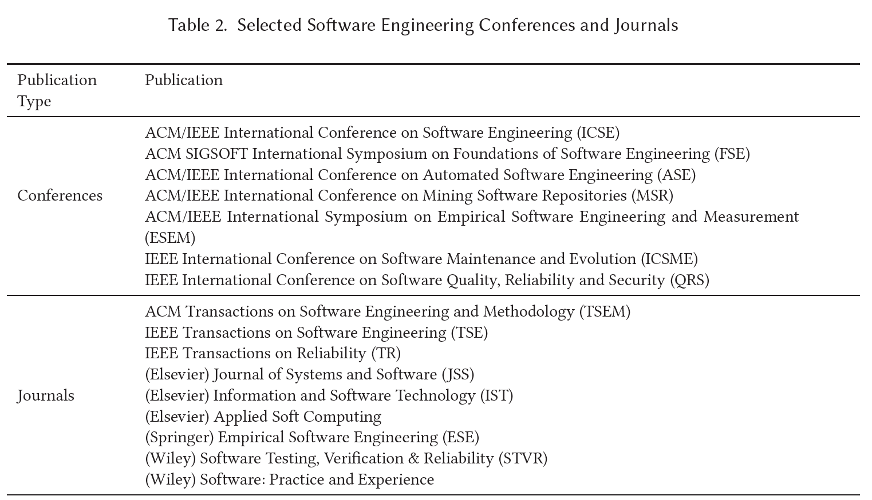
Paper Selection Method(1/2)
Paper selection Method(1/2) | Paper selection Result(2/2)
Digital Library Keyword Search
The digital library keyword search may not identify all of the relevant studies.
To alleviate this problem, we use the snowball method to discover new studies starting
with the selected articles from the previous step. We consider a variant of the snowball method called the backward (or reverse) snowball where we examine the references of an identified article.
Empirical evidence suggests that the snowball method should be effective to locate “high quality sources in obscure locations [20].”

Slide 9
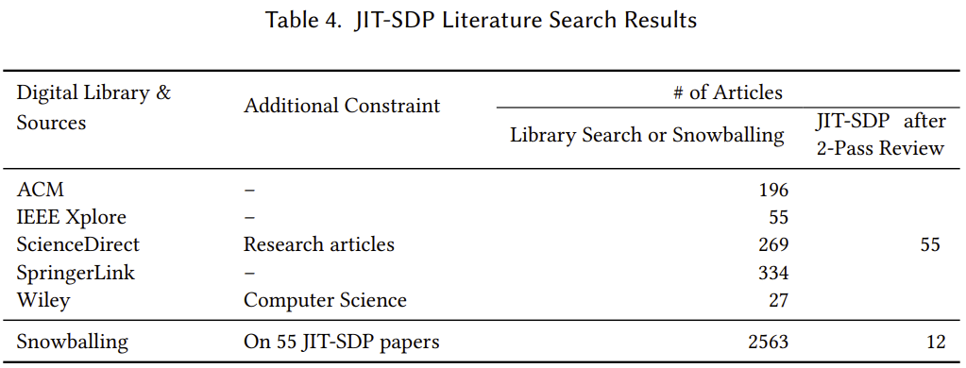
Paper Selection Result (2/2)
Paper selection Result(2/2) | Publication Trend
Paper selection results after 2-Pass Review:
1) we remove any article whose title clearly indicates that it is not relevant.
2) we evaluate whether or not to include them by reading the abstract for the remaining articles.
3) we convene a meeting and resolve the difference via a discussion.
# papers from libraries before Nov 2021 | # papers since Dec 2021 | Snowballing before Nov 2021 | Snowballing since Dec 2021 | # Total
55 | 19 | 12 | 2 | 88
Notes:
Mention the data is from the paper and new search

Slide 10
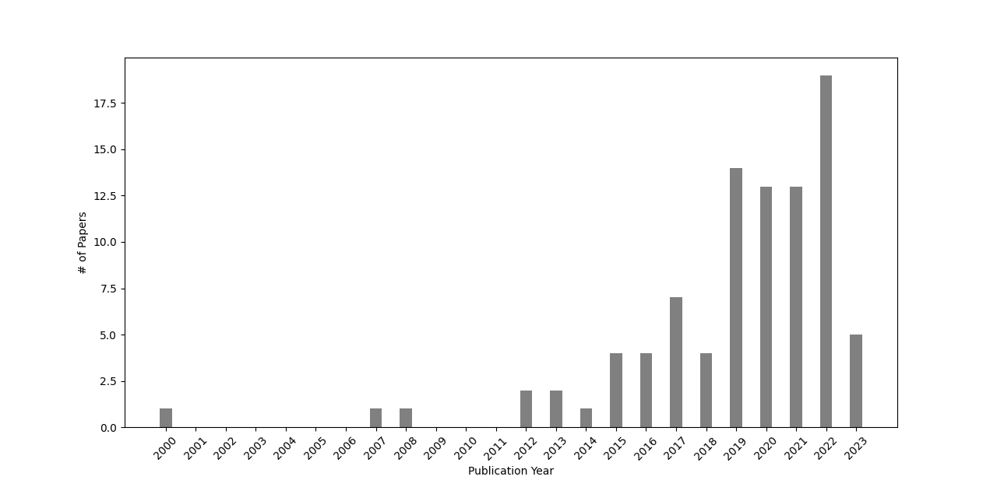
Publication Trend
Publication Trend | Flow of JIT-SDP
The number of selected JIT-SDP papers over publication year

Slide 11
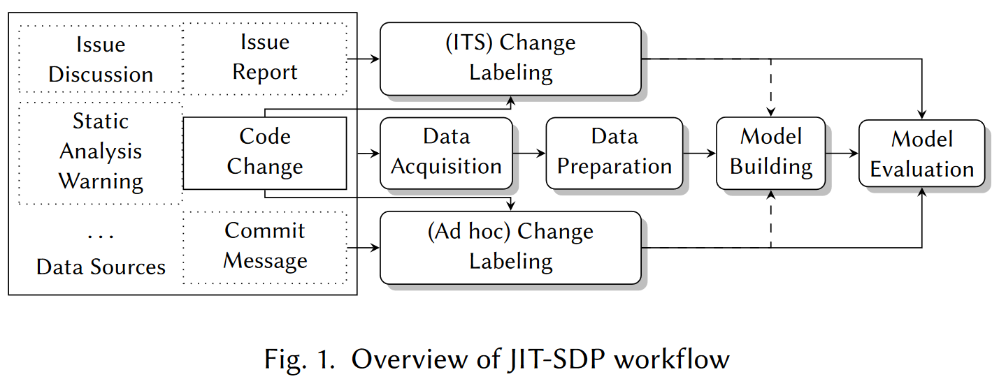
Overview of JIT-SDP
Flow of JIT-SDP | Overview
Data sources: code change, commit message, issue reports…
Data Acquisition: covert source data into raw feature vectors, like software metrics
Change Labeling: identify the defect introducing change from a fix change(Ad hoc: commit message; Issue tracking system(ITS))
Data Preparation: Preprocessing, like class imbalance,

Slide 12
Overview
Overview | Data Source
Introduction
Paper Selection and Publication Trend
Publication Trend
Overview of JIT-SDP
Review of Just-in-time Software Defect Prediction
Data Sources
Feature Acquisition and Processing
Defect-Inducing Label Assignment
Data Transformation
Modeling
Evaluation
Analysis and Open Questions
Future Research
Conclusion

Slide 13
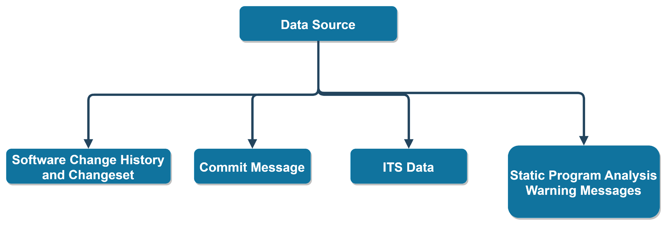
Data Source | Changeset Definition
Data Sources

Slide 14
Changeset Definition | Changeset Explanation
Data Sources Software Change History and Changeset(1/2)
Developers typically record all software changes as commits to a Source Code Management (SCM) system or a Version Control System (VCS).
A software change (i.e., changeset) is the difference between two revisions of the software code during the development process regard to the SCM.
Upon completing a modification to a software project, a developer records the change to a SCM using the commit command, which results a creation of a new revision number in the SCM. We can then define a software change as the difference of two revisions in succession in the SCM, e.g., the output of the git diff command.
Notes:
Upon completing a modification to a software project, a developer records the change to a SCM using the commit command, which results a creation of a new revision number in the SCM. We can then define a software change as the difference of two revisions in succession in the SCM, e.g., the output of the git diff command.

Slide 15
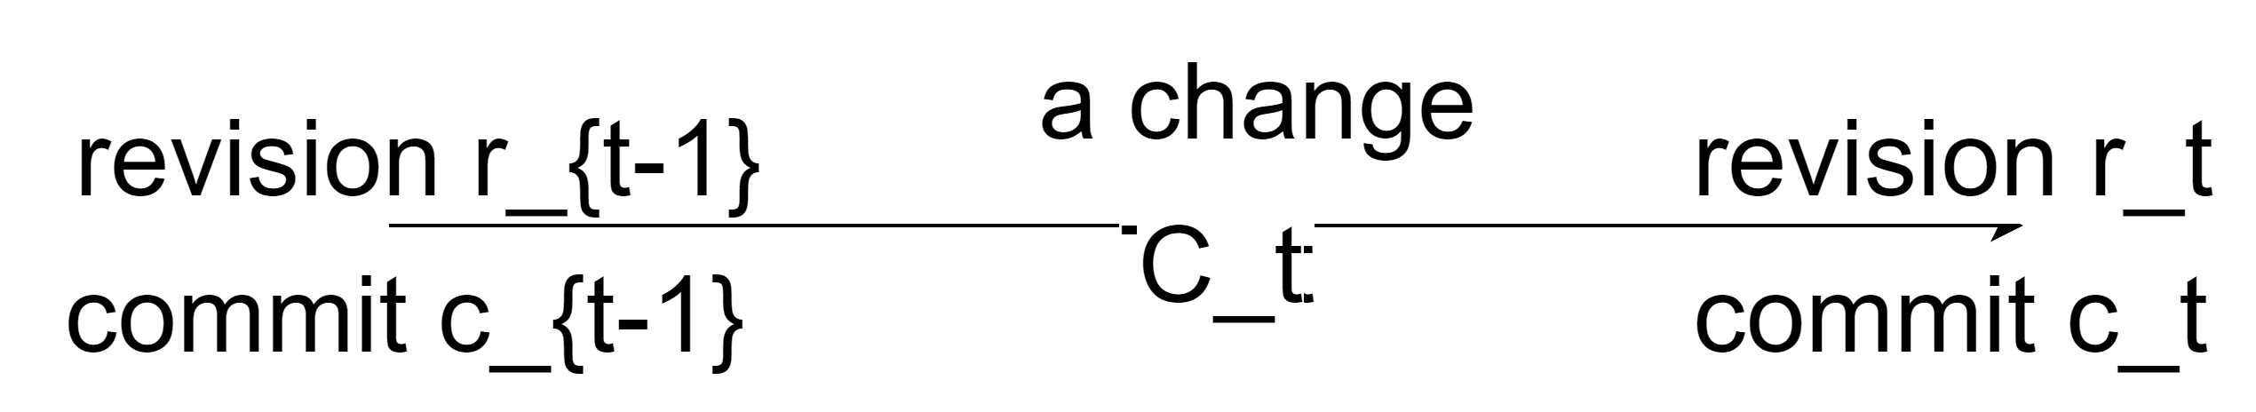
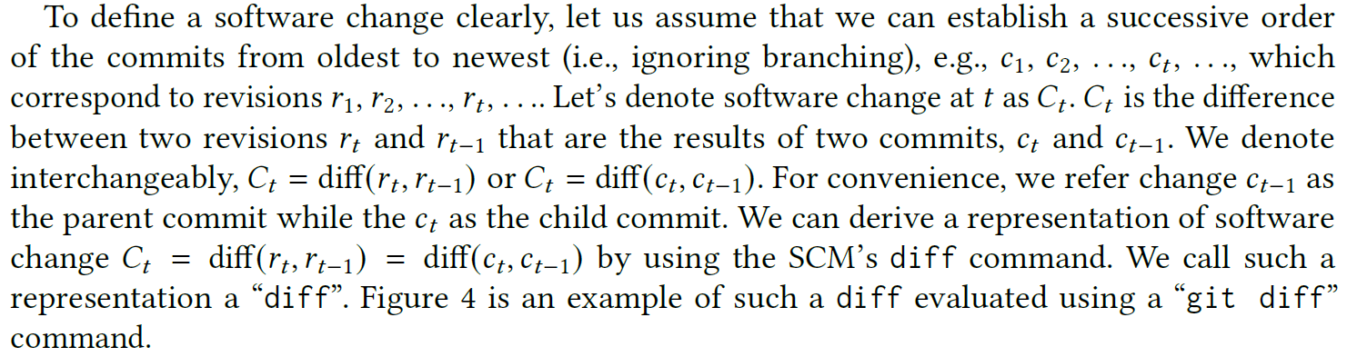
Changeset Explanation | Changeset Example
A software change (i.e., changeset) is the difference between two revisions of the software code during the development process regard to the SCM.
Data Sources:
Software Change History and Changeset(2/2)
Notes:
Upon completing a modification to a software project, a developer records the change to a SCM using the commit command, which results a creation of a new revision number in the SCM. We can then define a software change as the difference of two revisions in succession in the SCM, e.g., the output of the git diff command.

Slide 16
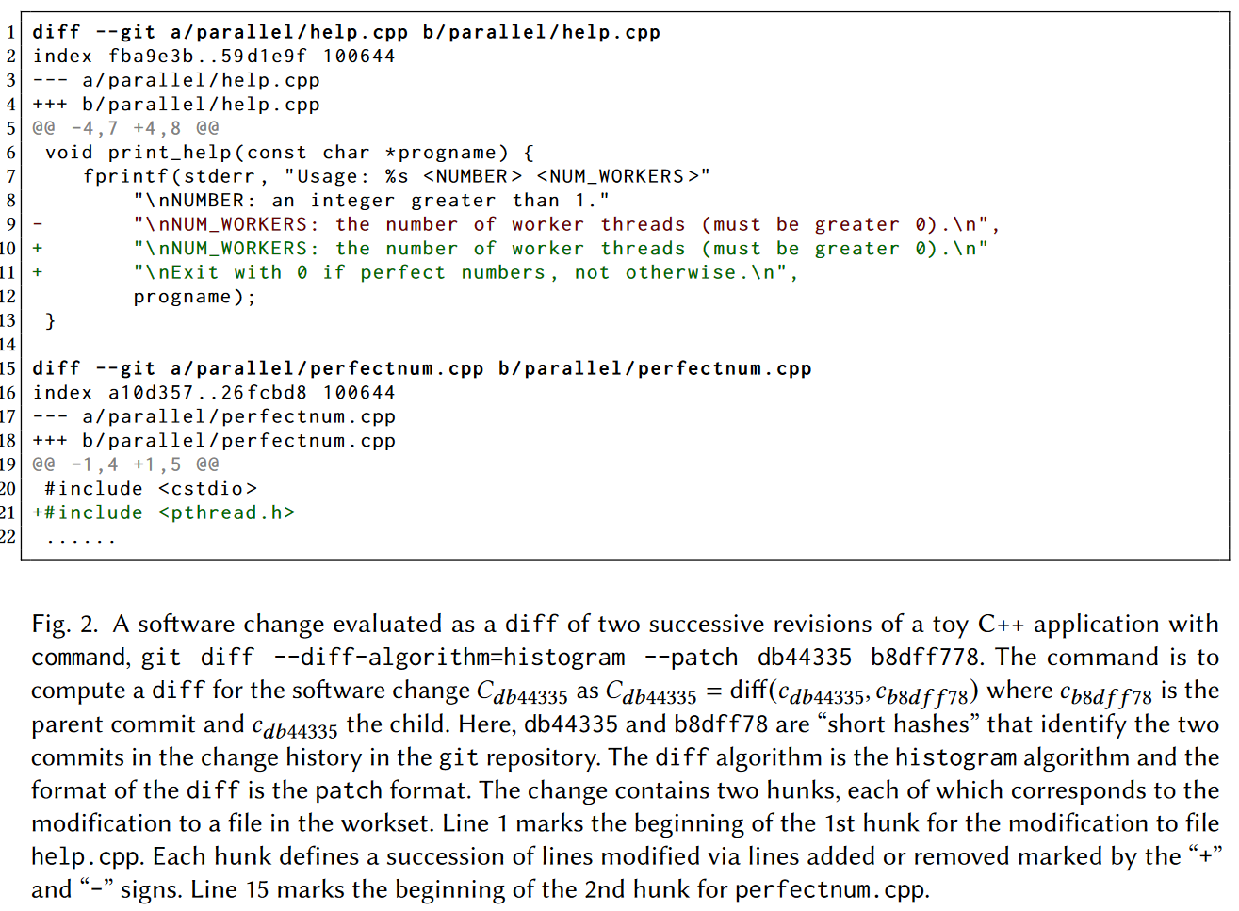
Changeset Example | Factors that impact the quality of the data
Notes:
A software change (i.e., changeset) is the difference between two revisions of the software in a SCM (e.g., git).
Upon completing a modification to a software project, a developer records the change to a SCM using the commit command, which results in a creation of a new revision number in the SCM.
We compute a software change as the difference of two successive revisions in the SCM, e.g., the output of the git diff command.
Figure 2 is an example of a software change computed by the git diff command containing two hunks. Each of the hunks corresponds to a part of a file in the commit, consisting of one or more
nearby modifications, i.e., lines of code added or deleted.

Slide 17
Factors that impact the quality of the data: diff algorithms | SCM capabilities vary
Data Sources: Quality of changes
There are complexities extracting software change data sets that impact the quality of the data. Factors that impact the quality of the data:
Like, git defines four diff algorithms, myers, minimal, patience, and histogram.
Nugroho et al. [53] observe that there is a considerable difference among the results extracted using different diff algorithms. The difference is at the numbers of changed lines and the locations of change lines.
Via a manual analysis of multiple Java projects, they observe that the histogram algorithm produces more accurate diffs and assert that the improvement of diff quality can lead to more accurate computation of code churn metrics and identification of defect inducing changes.
1) A variety of diff algorithms to compute differences between two files
However, whether and how the accuracy of diffs impact performance of JITSDP is unclear as the choice of the diff algorithm is rarely in the discussion of prior JIT-SDP studies.

Slide 18
SCM capabilities vary | SCM model and version
Data Sources: Quality of Changes
2) SCMs have varying capabilities to maintain revisions
3) Different controlling abilities of VCS on information passing into next revision
In earlier SCMs like CVS, revision numbers are per file.
In more recent SCMs, including both git and subversion, revision numbers are per workset, where a workset is a list of files that a developer changes together.
Some software projects transition between different repositories (e.g., CVS to git).
Git allows a developer to control which modifications will be in the next revision;
Subversion revision includes all modifications in the next revision
However, it is unclear whether these changesets are comparable and how they impact the interpretation of the results.
This difference may have an impact on the likelihood of commits that reflect an intentional, coherent change to the software.

Slide 19
SCM model and version | Data Source: Summary -> Commit Message
Data Sources: Quality of Changes
4) Two versioning models
5) Anonymous development branches are common in git repositories
lock-modify-unlock model
copy-modify- merge model, like git and subversion
copy-modify- merge model allows concurrent modifications to the same file,
as a result, there are revisions that are only the merges of concurrent modifications.
Distributed SCMs like git record all revisions locally until the developer pushes the local revisions to the central repository. The recorded commit time is the local time of the committer, which may lead a wrong order of successive changes
Trautsch et al. [75] observe this phenomenon and build a Directed Acyclic Graph of commits to “gain improvements with regard to changes on different branches.” However, they do not provide a comparison to the case of identifying parent commits via commit time.
Tan et al. [69], Cabral et al. [7], and Tabassum et al. [68] study online JIT-SDP and only leverage the chronological order of software changes
How we should best determine the order of software changes and how the order impacts on defect prediction remains an open research question.
A merge revision in the SCM has two parent revisions.

Slide 20
Data source: Commit Message | Data Source: Commit Message Example
Data Sources

Slide 21
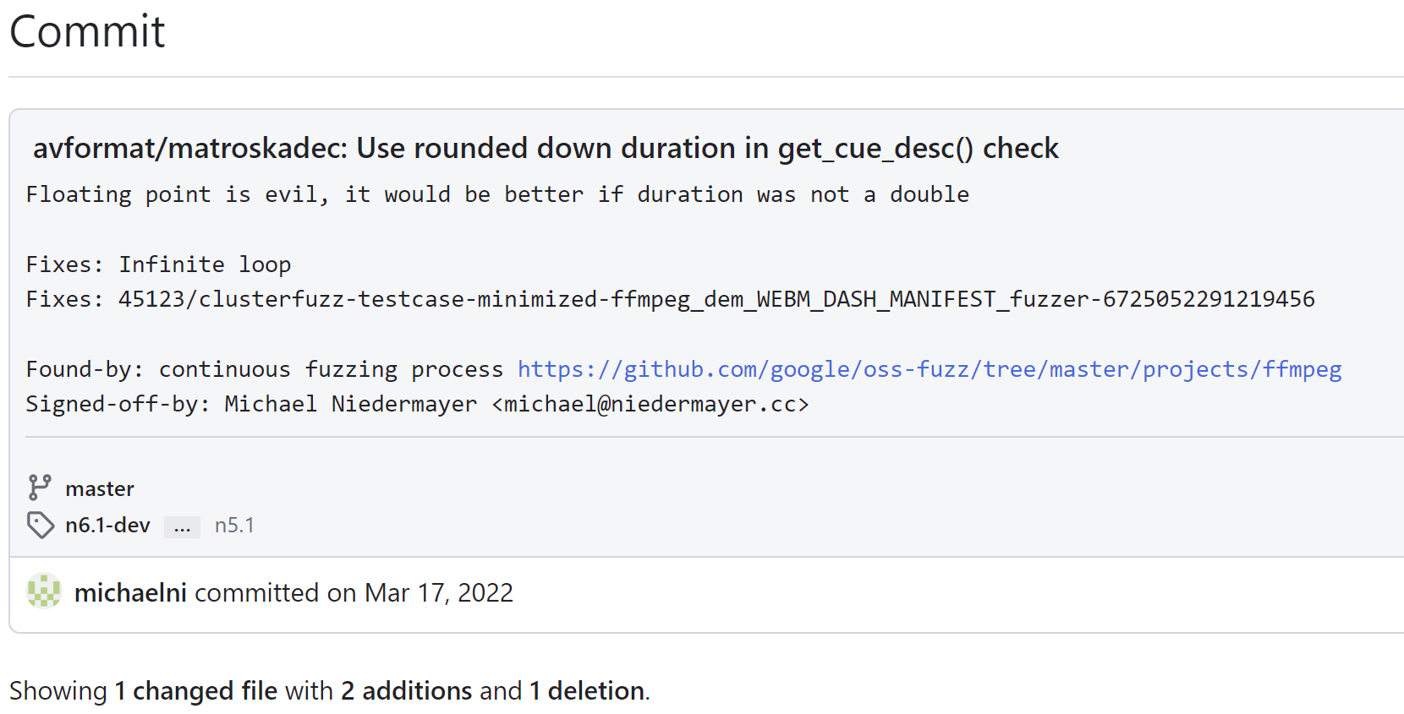
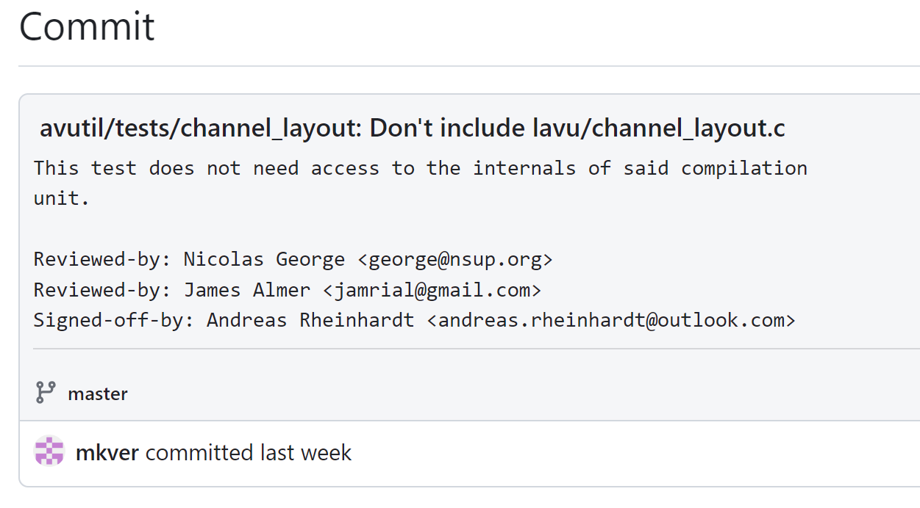
Data Source: Commit Message Example | Data Source: Commit Message Review
Data Sources: Commit Message
https://github.com/FFmpeg/FFmpeg/commit/bdc4553a7726d779e64f734b8cacfd5b9e293fb7
https://github.com/FFmpeg/FFmpeg/commit/bd3a03db9aef72ee36a7cc964171e9f52967f4bc

Slide 22
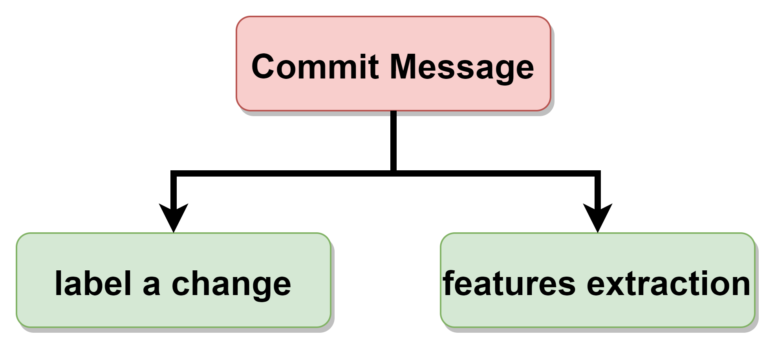
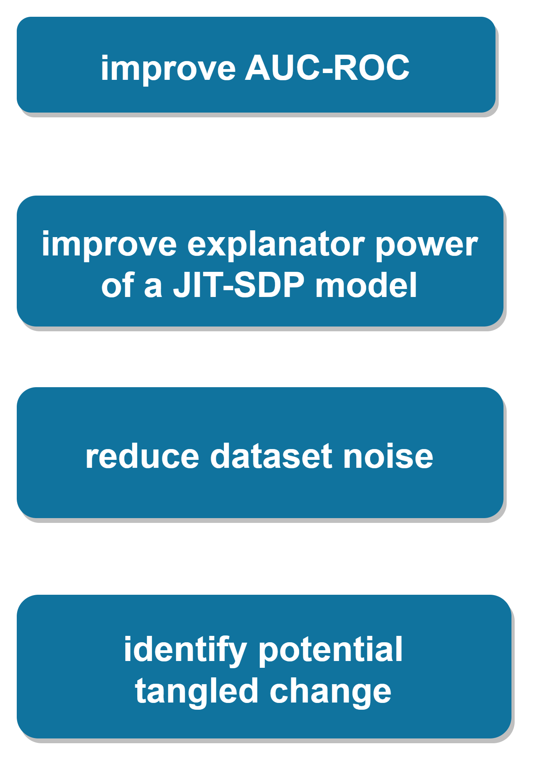
Data Source: Commit Message Review | Data Source: Summary -> ITS
Data Sources: Commit Message
Barnett et al. [3] propose a metric that measures the level of detail in commit messages.
They demonstrate that adding the metric can significantly improve AUC-ROC and explanatory power of a JIT-SDP model with change-based metrics. Hoang et al. [24] also observe that their deep neural network JIT-SDP model has improved AUC-ROC when adding commit messages to the features.
In addition, commit messages may also be useful to reduce noise in the software change data. For instance, Herzig et al. [23] investigate tangled software changes where developers commit unrelated or loosely related code changes in a single commit transaction.
They use commit messages to identify potential tangled changes and show that untangling tangled changes can result in more accurate regression-based defect prediction models.

Slide 23
Data Source: ITS | Data Source: ITS Example
Data Sources

Slide 24
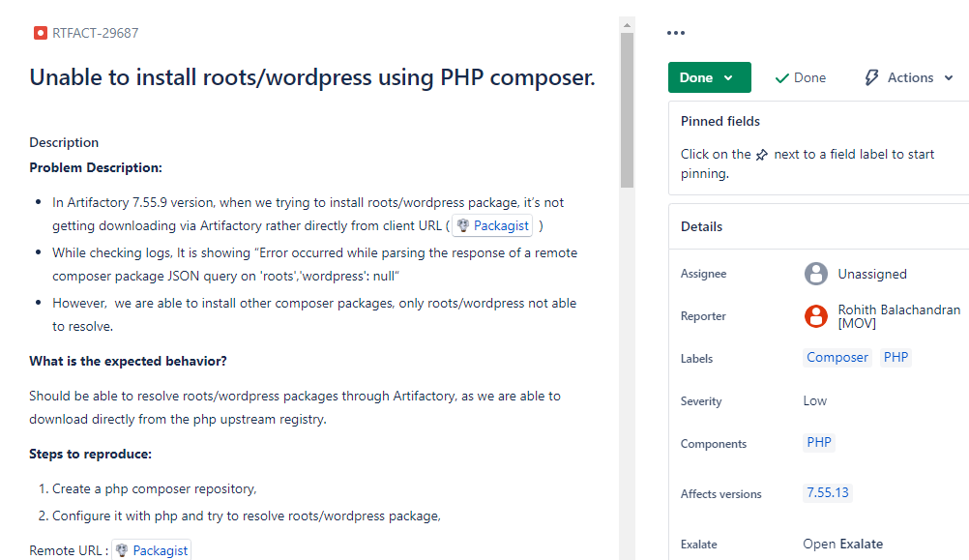
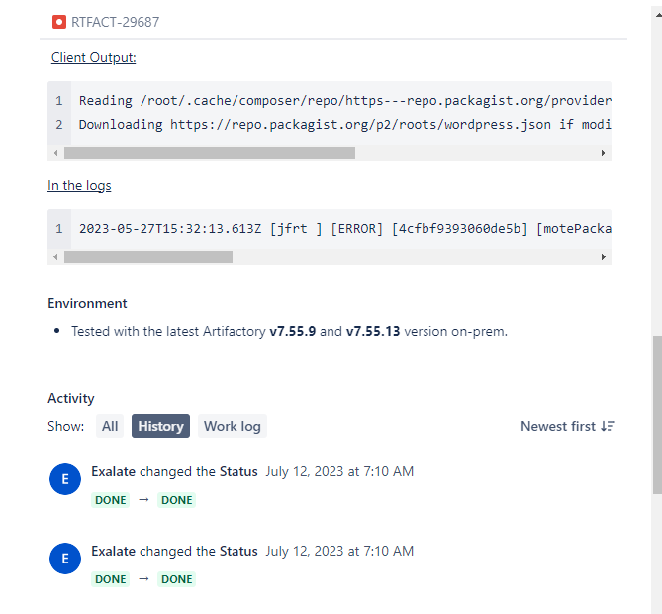
Data Source: ITS Example | Data Source: ITS Review
Data Sources: Issue Tracking System(ITS) Data

Slide 25
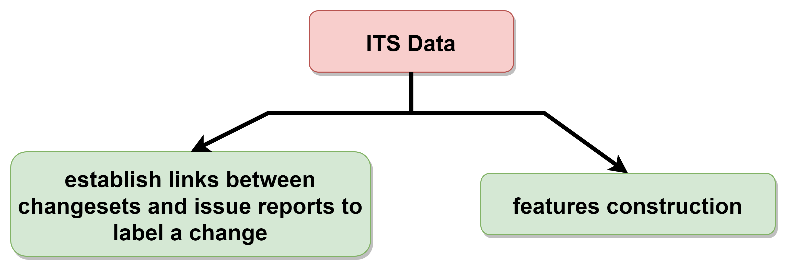
Data Source: ITS Review and challenge | Data Source Summary > Static Program Analysis
Data Sources:
Issue Tracking System(ITS) Data
Although uncommon, ITS data, such as, the issue reports, discussions, change requests, can be useful to JIT-SDP.
Tourani and Adams [74] and Tessema and Abebe [72] appear to be the only studies that investigate the use of some of these ITS data as features for JIT-SDP. Both show that their JIT-SDP models built using the features extracted from this type of data in addition to software change metrics outperform those using the software change metrics alone.
There are two challenges utilizing the types of data as features.
First, many changesets may not have a corresponding issue report in the ITS.
Second, it requires to establish links between ITS data and changesets in the software repository.
Noticing the difficulty of this requirement, Paixao et al. [54] curate a data set of code reviews and link them to revisions of source code. Data sets like this may help a broader adoption and further exploration of the ITS data in defect prediction.

Slide 26
Static Program Analysis Warning Message | Static Program Analysis Warning Message Review
Data Sources

Slide 27
Static Program Analysis Warning Message Review | Overview -> Feature Acquisition and Processing
Data Sources: Static Program Analysis Warning Messages
Warning messages produced by static program analysis tools (e.g., lint)
Trautsch et al. [75] derive from the warning messages a warning density feature,
i.e., the ratio of the number of static analysis warnings to the product size.
Their results show that features extracted from the static program analysis warning messages are among the top 10 most important features for defect prediction.
Challenge: a full static program analysis takes significant computational time to complete on a large code base [61] and for each changeset
Solution: perhaps by performing only partial, lightweight static analysis
Home

Slide 28
Overview
Feature Acquisition and Processing Summary | Feature Acquisition and Processing Summary
Introduction
Paper Selection and Publication Trend
Publication Trend
Overview of JIT-SDP
Review of Just-in-time Software Defect Prediction
Data Sources
Feature Acquisition and Processing
Defect-Inducing Label Assignment
Data Transformation
Modeling
Evaluation
Analysis and Open Questions
Future Research
Conclusion

Slide 29
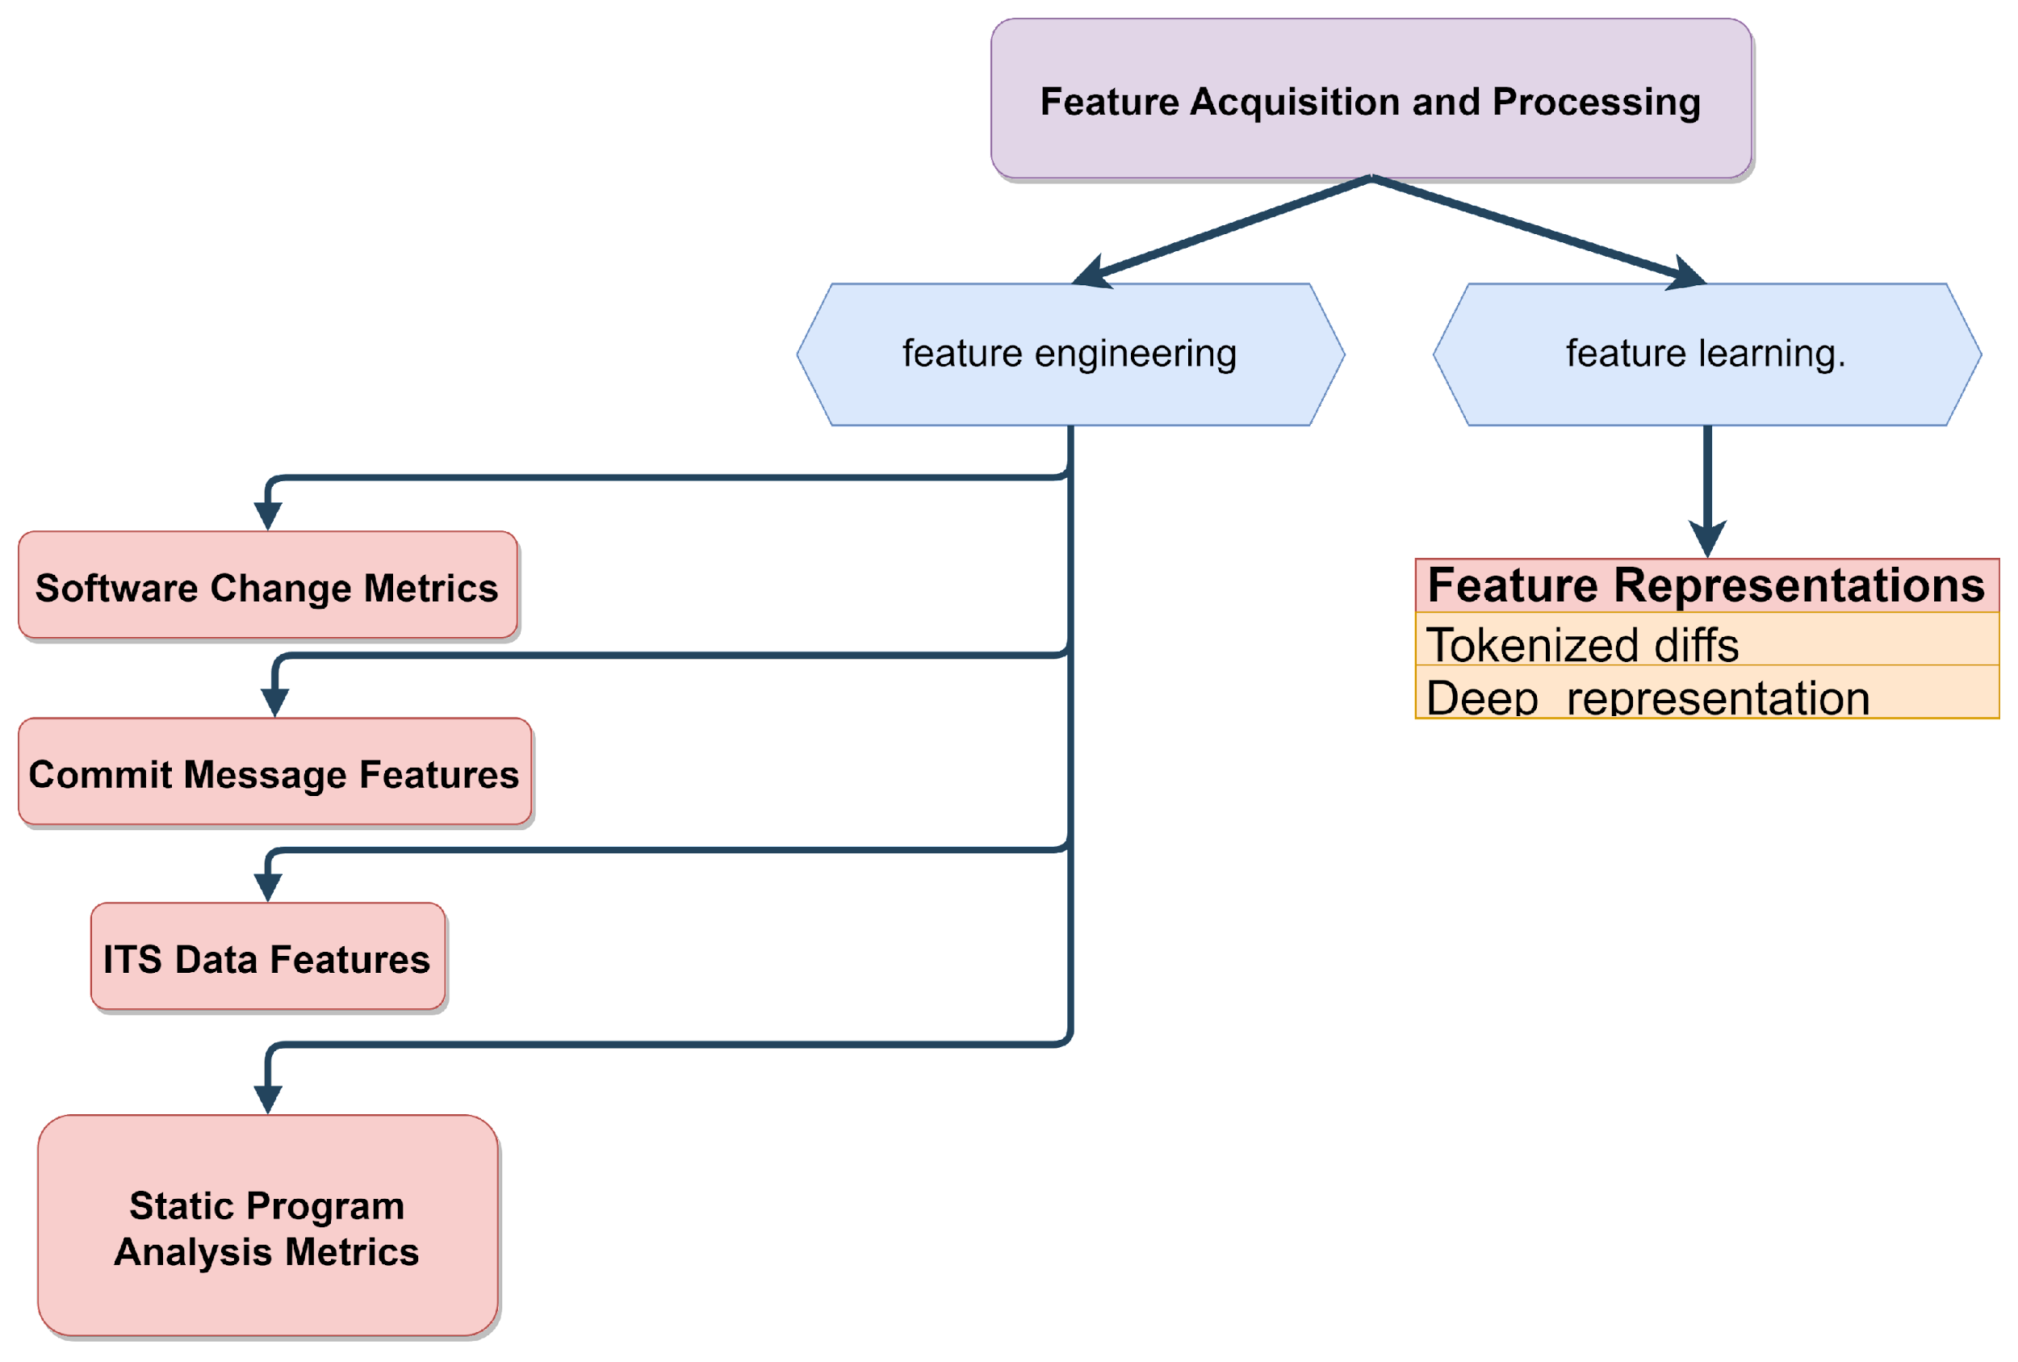
Feature Acquisition and Processing
Feature Acquisition and Processing Summary | Feature Engineering Summary
What information do we need to extract from the data?
How do we extract them from the several types of input data discussed in the previous section?
Solutions: feature engineering (manually) and feature learning (algorithmically)

Slide 30
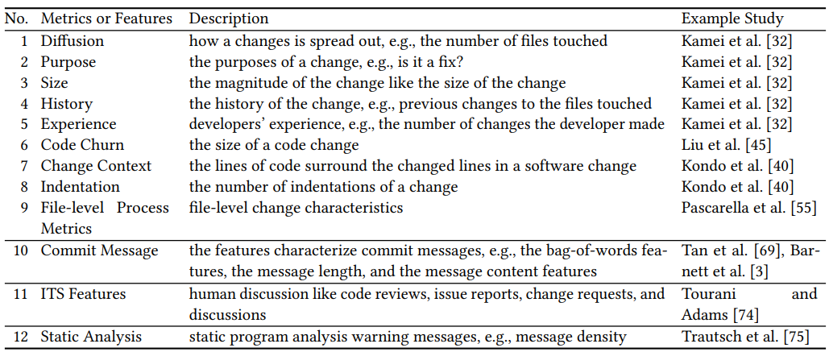
Feature Engineering
Feature Engineering Summary | Feature Engineering: Features from Software change history
Manually Designed Features for JIT-SDP

Slide 31
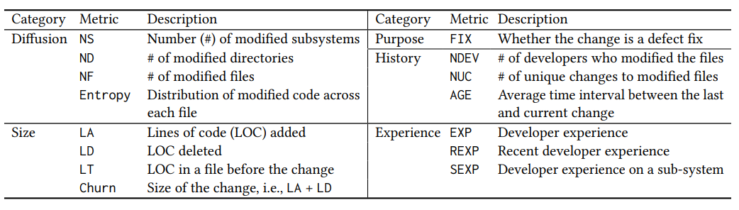
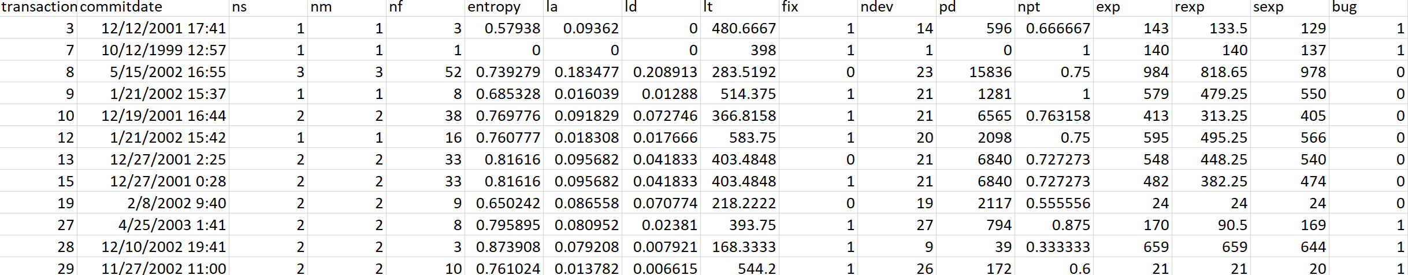
Feature Engineering: Software Metrics
Feature Engineering: Features from Software change history | Feature Engineering: Features from Commit Message
Software change metrics are those directly computed from the software code of the changes, e.g., the diffs.

Slide 32
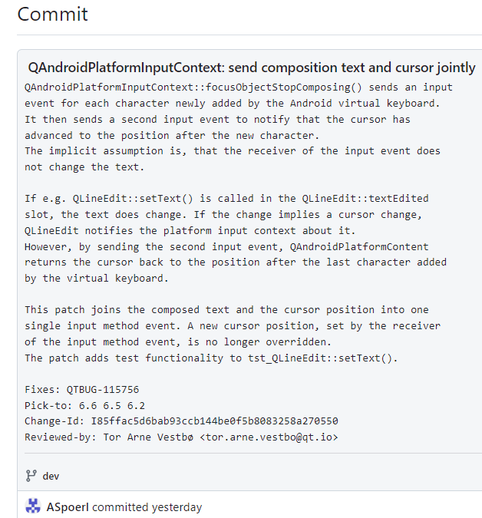
Feature Engineering: Commit Messages(1/2)
Feature Engineering: Features from Commit Message(1/2) | Feature Engineering: Features from Commit Message(2/2)
Since commit messages are written as natural language text, features to encode them are usually borrowed from the natural language processing literature. These features include bag-of-words, the message length, and the message content features [3, 69].

Slide 33
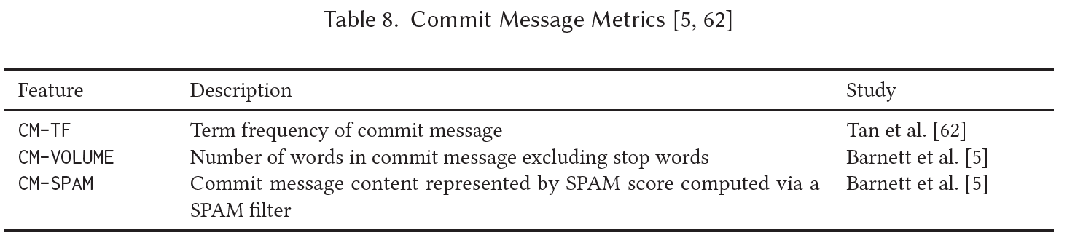
Feature Engineering: Commit Messages
Feature Engineering: Features from Commit Message(2/2) | Feature Engineering: Features from ITS(1/2)
An example is term frequency (TF) that counts the occurrences of a specific word in the commit message, e.g., used by Tan et al. [62].
Barnett et al. [5] hypothesize that the level of detail in commit messages is useful for JIT-SDP and confirm it
via their investigation of more than 300 repositories.

Slide 34
Feature Engineering: Features from ITS(1/2) | Feature Engineering: Features from ITS(2/2)
Feature Engineering: ITS Data(1/2)
ITS contains two types of data:
natural language text, such as, issue reports, issue discussions, and code reviews
meta-data, such as, the type of issues and the issue creation time.
Prior JIT-SDP studies design and investigate features mostly capturing the characteristics of the ITS data other than actual textual contents [72, 74].

Slide 35
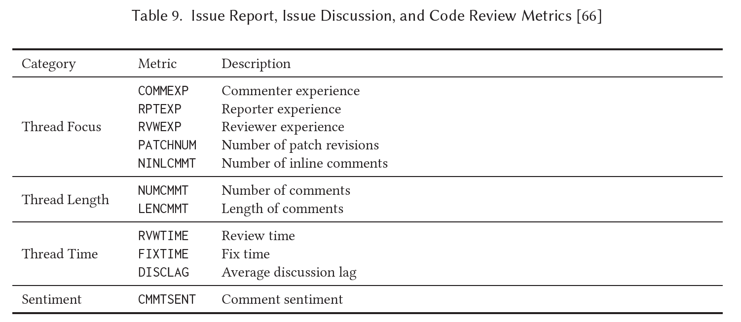
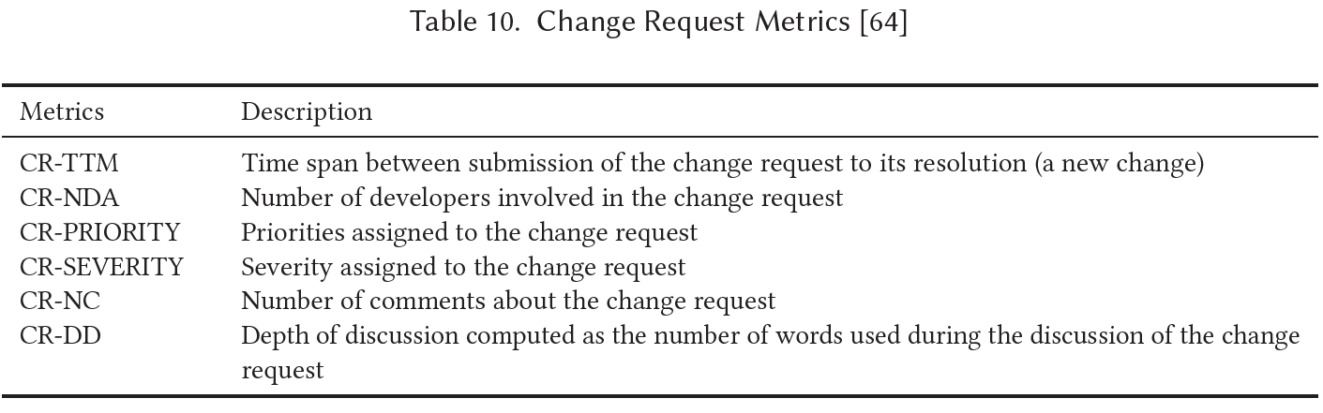
Feature Engineering: Features from ITS(2/2) | Feature Engineering: Features from Static Program Analysis
Feature Engineering: ITS Data(2/2)
Tourani and Adams [66] propose a suite of issue discussion and code review discussion metrics that attempt to capture the characteristics of these data sources other than actual textual content.
Tessema and Abebe [64] propose 6 metrics for change requests in ITS.

Slide 36
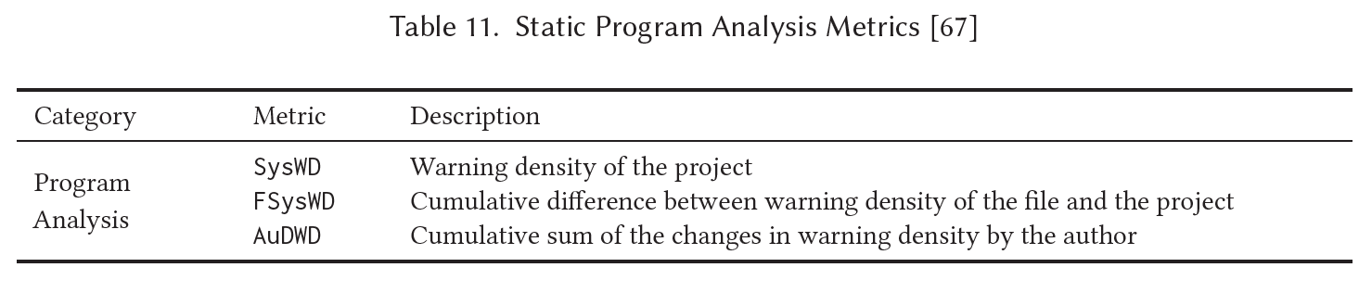
Feature Engineering: Features from Static Program Analysis | Feature Learning
Feature Engineering: Static Program Analysis
Trautsch et al. [75] collect static program analysis warning messages using two popular tools, PMD and OpenStaticAnalyzer. From these warning messages, aimed at JIT-SDP, they derive several warning density metrics.

Slide 37
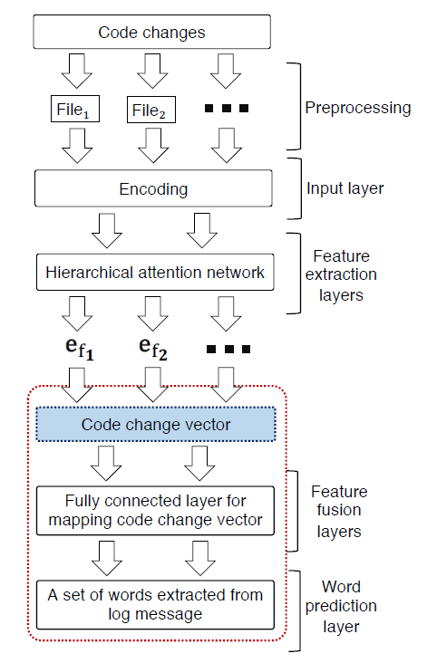
Feature Learning | Overview: Defect-Inducing Label Assignment
Feature Learning
Two general approaches:
directly compute from software changes (e.g., tokenized diffs) the “end-to-end” feature representation [24, 25].
take human designed features as inputs to learn feature representations, which Yang et al. [83] refer to as the “expressive features”.
Hoang et al. [25] propose a deep learning architecture, namely CC2Vec,
that learns distributed representations of code changes guided
by the semantic meaning contained in log messages.
CC2Vec takes the code change of a patch as input and generates its distributed representation. CC2Vec uses the first line of the log message of the patch to supervise learning the code change representation.
Notes:
• Preprocessing: This part takes information from the code change of the given patch as an input and outputs a list of files. Each file includes a set of removed code lines and added code lines.
• Input layer: This part encodes each changed file as a three-dimensional
matrix to be given as input to the hierarchical attention network (HAN) for extracting features.
• Feature extraction layers: This part extracts the embedding vector (a.k.a. features) of each changed file. The resulting embedding vectors are then concatenated to form the vector representation of the code change in a given patch.
• Feature fusion layers and word prediction layer: This part maps the vector representation of the code change to a word vector extracted from the first line of log message; the word vector indicates the probabilities that various words describe the patch.

Slide 38
Overview
Overview: Defect-Inducing Label Assignment | Label Assignment 2 steps
Introduction
Paper Selection and Publication Trend
Publication Trend
Overview of JIT-SDP
Review of Just-in-time Software Defect Prediction
Data Sources
Feature Acquisition and Processing
Defect-Inducing Label Assignment
Data Transformation
Modeling
Evaluation
Analysis and Open Questions
Future Research
Conclusion

Slide 39
Defect-Inducing Label Assignment
Label Assignment 2 steps | SZZ and problems in the 2 steps
How do we assign the defect-inducing (i.e., defective) or clean label to a software change?
Two steps:
identify a defect-fixing change -> examine either commit log messages , or issue reports in ITS, or both. There are two commonly used heuristics.
One is to search for a natural language pattern in the text, e.g., “fixes”, “fixed”, “resolves”, “resolved”, “defect”, and “bug“ [32].
The other is to look for references to issue reports, e.g., “#123abc” [47].
locate the prior change that introduced the defect in -> locate the removed lines first appeared change
Search backward in the change history to find the changeset that introduced the defect.
Conceptually, this is possible because the current change fixes a defect, therefore the added lines are the fix and the removed lines contain the defect.

Slide 40
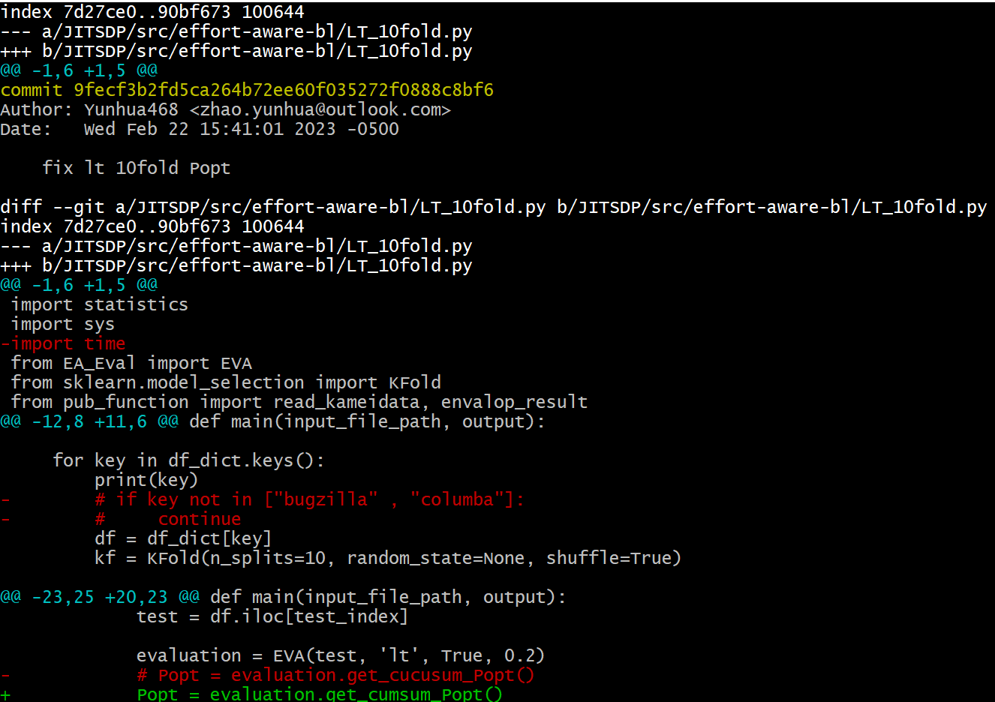
Defect-Inducing Label Assignment
SZZ and problems in the 2 steps | Issues could be caused by SZZ in detail
Śliwerski, Zimmermann, and Zeller [67] propose an algorithm to automatically identify defect-inducting changes, called SZZ
Investigations of the accuracy of this automated software change labeling have shown that:
it may not always be easy to identify a defect-fixing change (i.e., Step 1) [30, 35, 75]
it can also be difficult to locate the corresponding defect-inducing change (i.e., Step 2) [36, 52].

Slide 41
Defect-Inducing Label Assignment
Issues could be caused by SZZ in detail | Solutions from literature
Issues could be caused by SZZ:
1) keywords like “fixed”, “bug”, or “patch” to identify defect-fixing changes
2) the ”removed lines” in the defect-fixing change contain noise, like tangled changes
3) added the removed lines from the defect-fixing change, like formatting changes or refactoring changes
4) whether we can always attribute a defect to a single defect-inducing change, like “removed lines” in
the defect-fixing change may have come from multiple prior changes
There have been several implementations (or variants) of SZZ with the aim of addressing some
of these issues. Like:
how should we identify defect-fixing changes?
which implementation of SZZ should we use?
how do these choices impact JIT-SDP results?

Slide 42
Defect-Inducing Label Assignment
Solutions from literature | Overview -> Data Transformation
Trautsch et al. [75] differentiate “ITS SZZ” from “Ad Hoc SZZ”, where for the former they identify defect-fixing changes using explicit links in ITS and SCM, while for the later they use heuristics. They show that ITS SZZ offers an advantage in predictive performance. However, explicit links between ITS and SCM are not always available [32].
Quach et al. [59] discuss their choice of the SZZ implementations and give their preference to MA-SZZ [12]. Fan et al. [15] investigate the impact of the mislabeled changes by SZZ and assert that RA-SZZ [52], an extension to MA-SZZ is most accurate [15].
However, Rosa et al.’s recent investigation on SZZ implementations does not yield a clear support for these exact preferences [64].
Some researchers still suggest manual vetting of SZZ results to ensure highest quality data is used to construct the JIT-SDP model [15, 59]. However, this is time-consuming and difficult to do for developers that are unfamiliar with a particular software project.

Slide 43
Overview
Overview: Data Transformation | Data Transformation Summary
Introduction
Paper Selection and Publication Trend
Publication Trend
Overview of JIT-SDP
Review of Just-in-time Software Defect Prediction
Data Sources
Feature Acquisition and Processing
Defect-Inducing Label Assignment
Data Transformation
Modeling
Evaluation
Analysis and Open Questions
Future Research
Conclusion

Slide 44
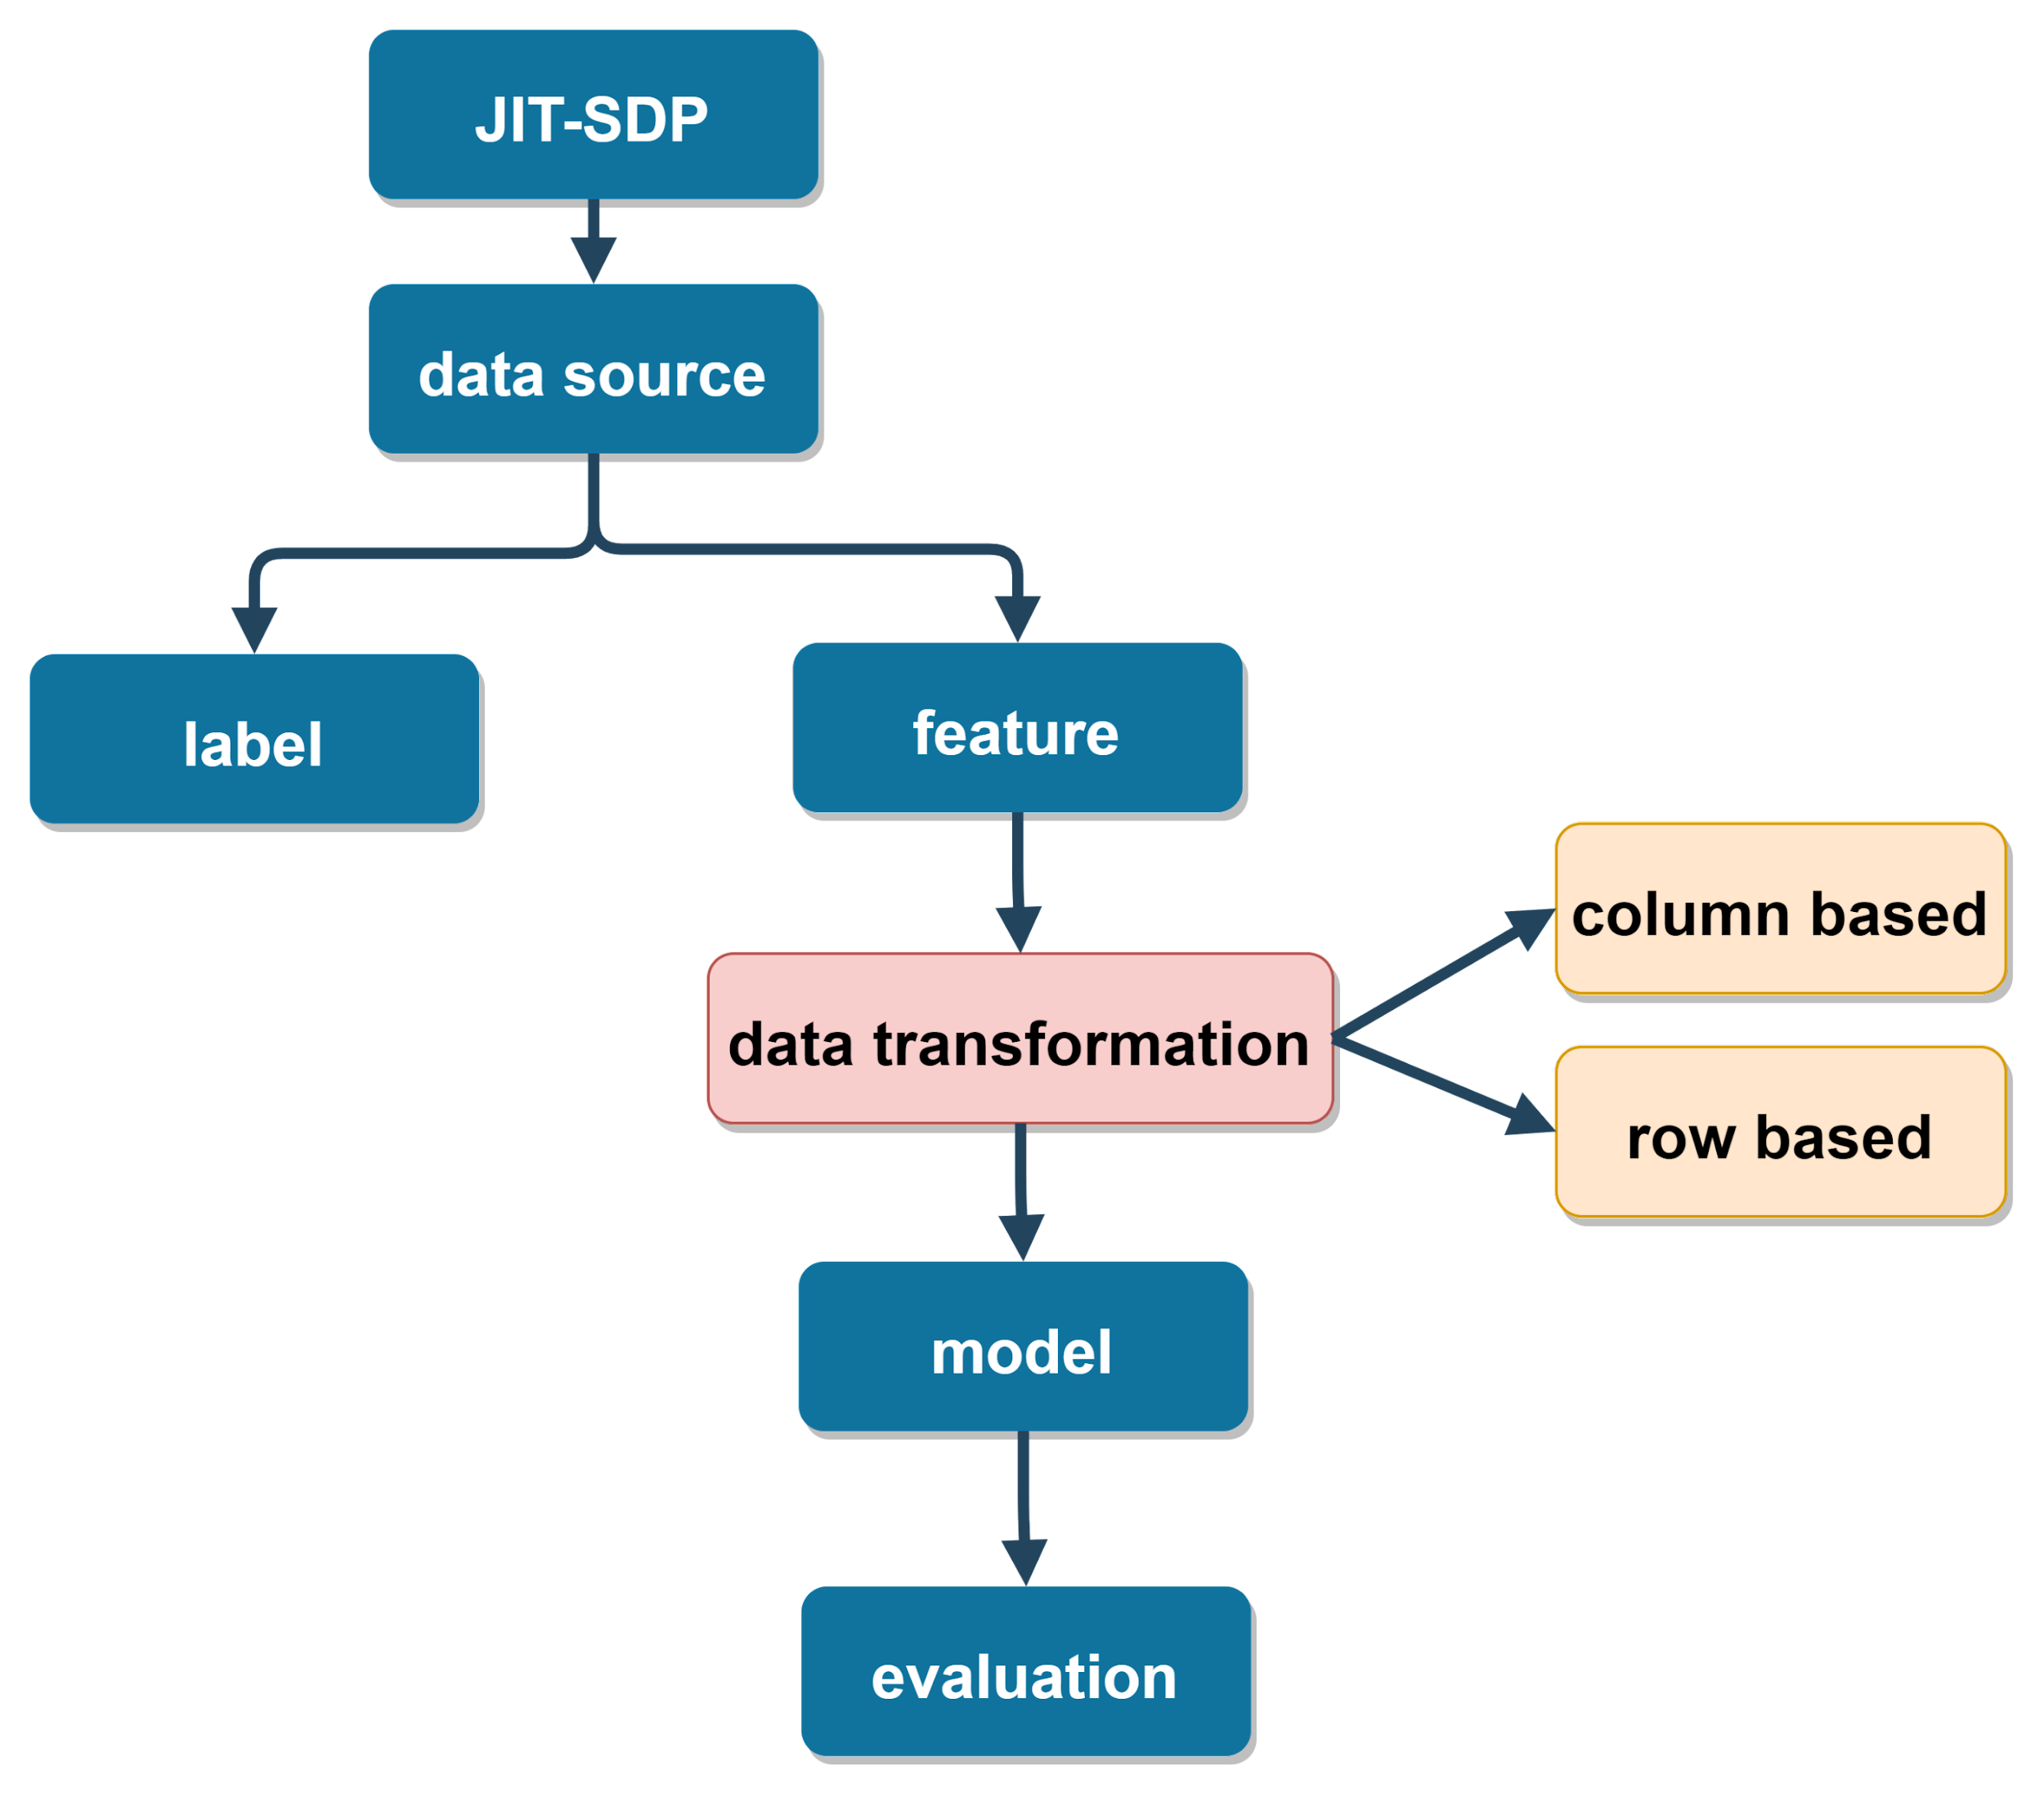
Data Transformation
Overview: Data Transformation Summary | Column based transformation necessary proof

Slide 45
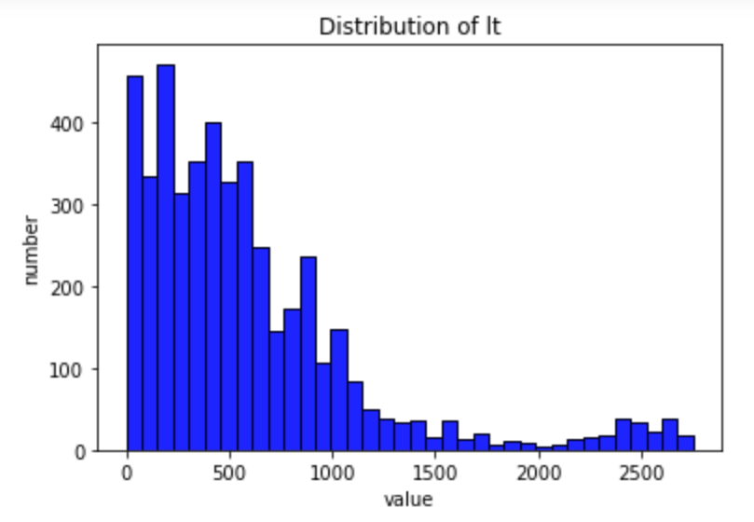
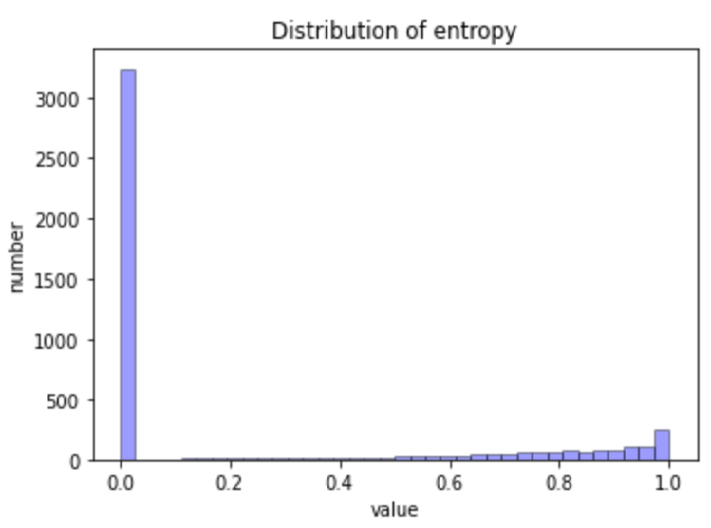
Data Transformation
Column based transformation necessary proof | Column based transformation methods
Lt and entropy histograms of Bugzilla

Slide 46
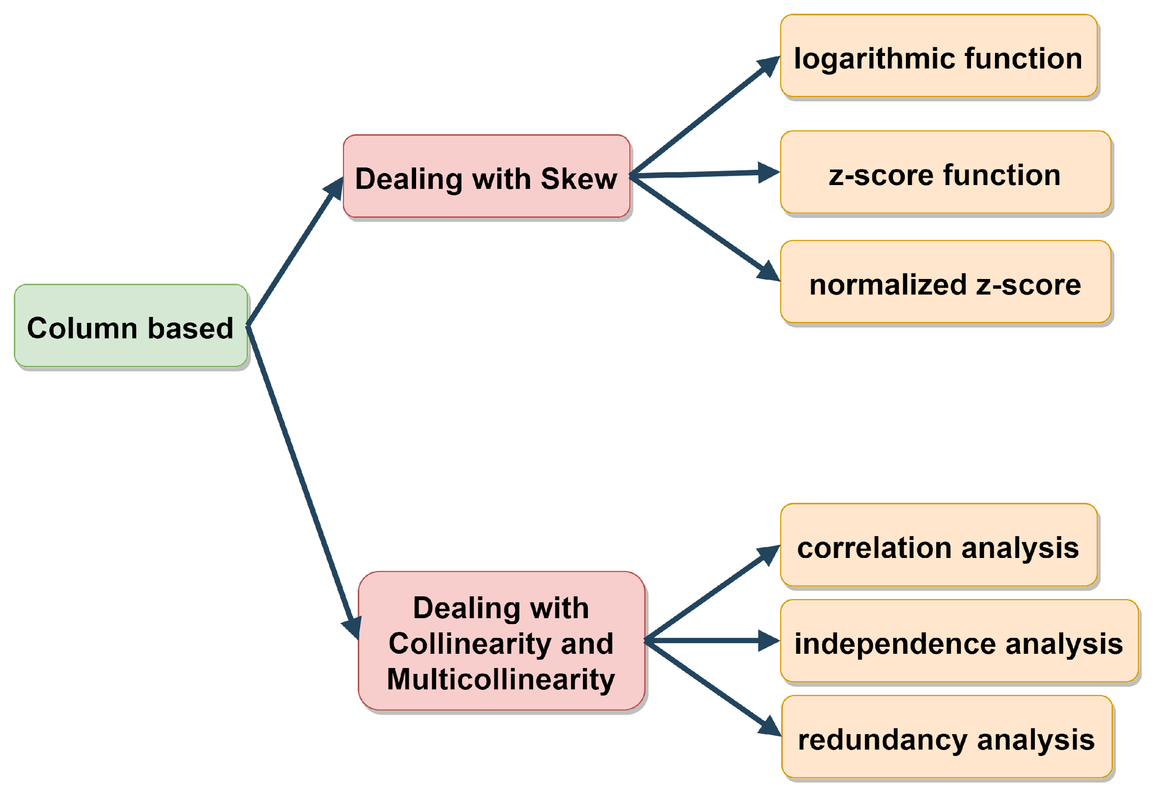


Data Transformation: column based
Column based transformation methods | Row based transformation necessary proof
if two variables are correlated,
keep the variable that helps ease model interpretation

Slide 47
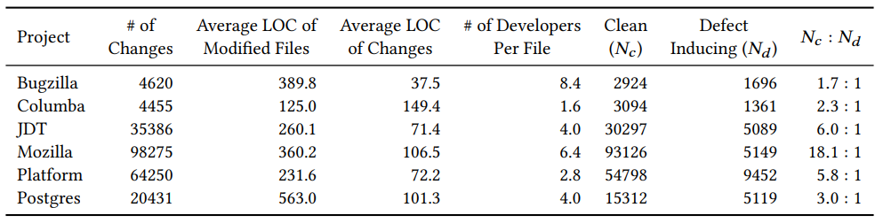
Data Transformation: row based
Row based transformation necessary proof | Row based transformation methods
Data is very imbalanced, which would impact the performance of models, like Sklearn decision trees

Slide 48
Data Transformation: row based(dealing imbalance)
Row based transformation methods | Overview -> Modeling
1) Resampling the original data set
Undersampling the majority class
Oversampling the minority class
A combination of them
Tan et al. [69] further divide the oversampling and undersampling class-balancing strategies into four methods, namely, Simple Duplicate, Synthetic Minority Over-sampling Technique (SMOTE), Spread Subsample, and Bootstrapping with/without Replacements.
The prior JIT-SDP studies adopt more frequently the undersampling and the SMOTE approaches than the others.
Researchers remain inconclusive on the optimal choice of data balancing strategies for JIT-SDP models.
2) Model design
When a JIT-SDP model is to minimize a loss function, we can assign a larger class weight to the minority class than do to the majority class [92]
An ensemble of classifiers can as a whole use all of the data while each of the classifier uses a balanced subset of the whole data set [82, 95].
we should also be cautious about balancing the data when the interpretation of the model is our primary concern since the balanced data may change the interpretation of the model, such as shift the ranking of the most important metrics [44].
Home

Slide 49
Overview
Overview: Modeling | Modeling Summary
Introduction
Paper Selection and Publication Trend
Publication Trend
Overview of JIT-SDP
Review of Just-in-time Software Defect Prediction
Data Sources
Feature Acquisition and Processing
Defect-Inducing Label Assignment
Data Transformation
Modeling
Evaluation
Analysis and Open Questions
Future Research
Conclusion

Slide 50
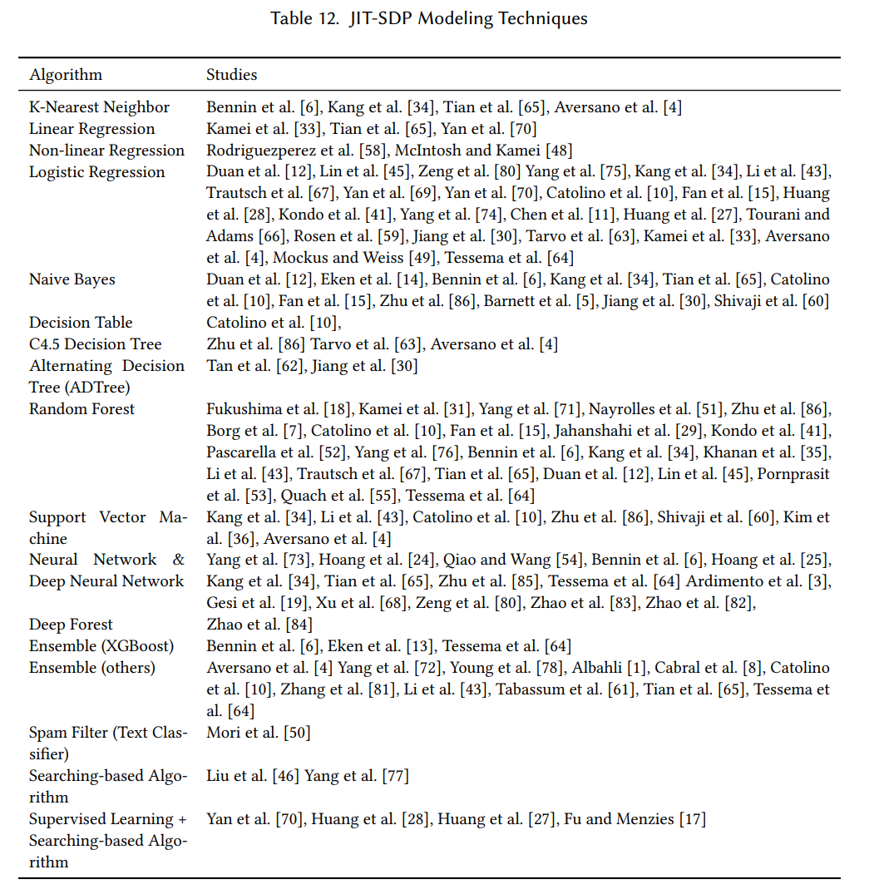
Modeling
Modeling Summary | Modeling Settings
Table 12 lists the modeling techniques in the prior JIT-SDP studies.

Slide 51
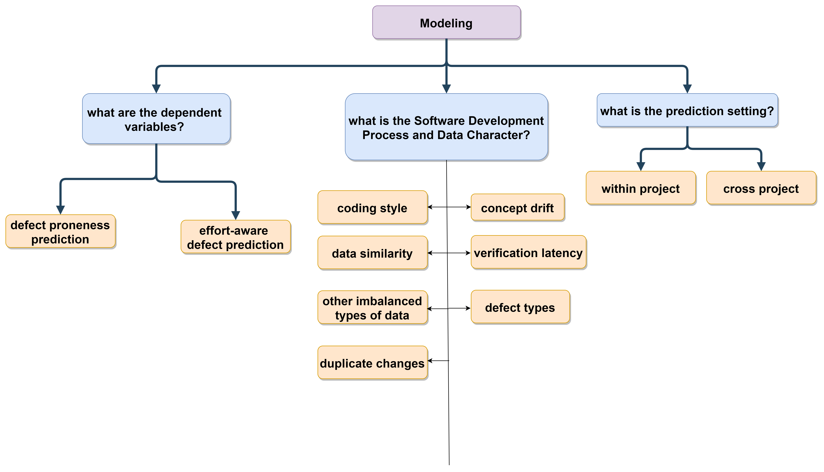
Modeling
Modeling Settings Summary | Defect Proneness Prediction Modeling
Notes:
There are several key decisions we ought to make in JIT-SDP Modeling.

Slide 52
Modeling: Defect Proneness Prediction
Defect Proneness Prediction Modeling | Effort-Aware Defect Prediction Modeling
Defect Proneness Prediction: JIT-SDP is typically formulated as predicting defect proneness or defect inducing at the granularity of software changes.
More popular modeling techniques
Logistic Regression
Tree-based models (including Random Forest, C4.5 Decision Tree and ADTree)
Ensemble models (including Random Forest, XGBoost, and others) are more popular modeling techniques
The use of neural network-based models (including deep neural networks) is on the rise.
Prediction Granularity:
JIT-SDP models are to detect defects primarily on the level of software changeset.
There are several studies that predict defects on finer granularity, such as, scoring files [55, 75], classes in the files [1], or lines added in a changeset [57, 79].
These works show that defect prediction on finer granularity can potentially further reduce quality
assurance effort than that on changeset-level granularity.

Slide 53
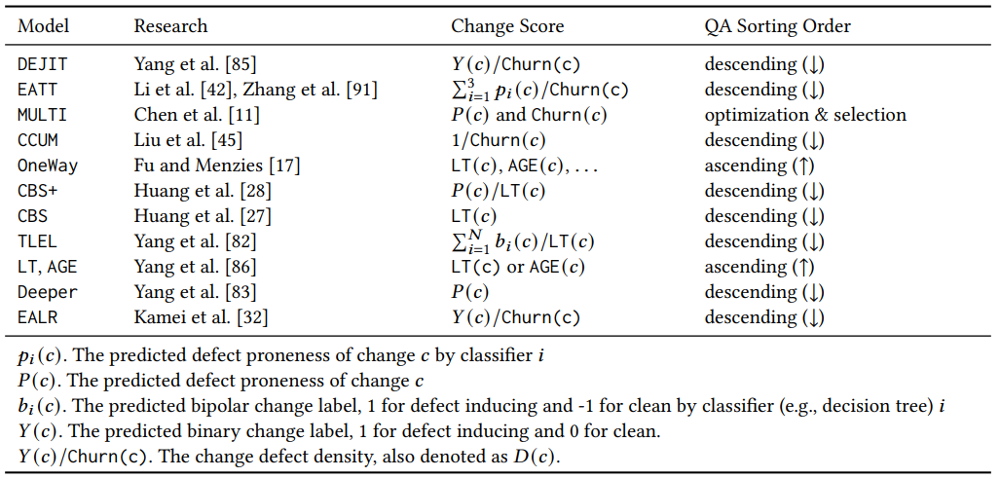
Modeling: Effort-aware Defect Prediction
Effort-Aware Defect Prediction Modeling | Modeling Overview -> Within/Cross Project
Effort-Aware Prediction: The effort required for developers to review the predicted defect inducing changes i.e., the QA effort, is an important design consideration.
All the studies in Table 6 define the QA effort for a change as the total lines changed,
i.e., Churn = LA + LD.
The models therein generally define an effort-awareness score to rank or to order the software changes for QA.
The score is either the change defect proneness, or the change defect density, or the QA effort, or some combination of the above.

Slide 54
Modeling
Modeling Overview: Within/Cross Project | Within/Cross Project
Notes:
There are several key decisions we ought to make in JIT-SDP Modeling.

Slide 55
Modeling: Within and Cross Project Defect Prediction
Within/Cross Project | Modeling Overview->Software Development Process and Data
Within-Project JIT-SDP (WP-JIT-SDP): train a prediction model from historical software change and defect data of one project, and to use the model to carry out defect prediction or effort-aware prediction for the same project
the historical change and defect data of a single software project may not be available or may not be sufficient to train a JIT-SDP model, e.g., in the initial development phase of the project
Solution
Cross-Project JIT-SDP (CP-JIT-SDP): build a prediction model from the change and defect data of one or more projects, and to use the model to predict defect prone changes for a project
What if two software projects may have significantly different characteristics?
data selection: select models trained using other projects that are similar to the testing project
data merging: combine the data of several other projects to produce a larger pool of training data
model ensembling: “combine the models of several other projects to produce an ensemble model

Slide 56
Modeling
Modeling Overview: Software Development Process and Data | Modeling: Concept Drift
Notes:
There are several key decisions we ought to make in JIT-SDP Modeling.

Slide 57
Modeling: Design for Concept Drift
Modeling: Concept Drift | Modeling: Verification Latency
Concept drift: the regularities in the data gradually change or shift
In a probabilistic model, we can define concept drift more formally as “changes in the underlying joint probability distribution of the problem [13]
McIntosh and Kamei [47] show that the characteristics of software change data fluctuate during the life cycle of software so significantly that the performance and interpretation of JIT-SDP models trained on old software change data can degrade greatly
Solution models:
McIntosh and Kamei [47] address the problem by providing a guideline on how to select recent software change data to train a JIT-SDP model
Cabral et al. [7] and Tabassum et al. [68] tackle the problem is via an incremental learning or an online learning

Slide 58
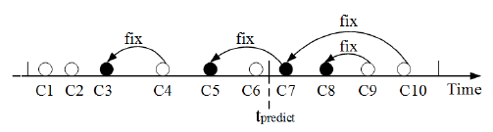
Modeling: Design for Verification Latency
Modeling: Verification Latency | Modeling: Defect Types
Verification Latency: A defect-inducing change always appears before its defect-fixing change.
A lag time between when a defect-inducing change is committed to the SCM and identified.
Cabral et al. [7] show that the verification latency ranges from 1 to 410 days among the 10 open source projects that they examine; and they assert that verification latency is more likely to affect newer changes than older ones.
Tan et al. [62]
Cross-validation, e.g., a k-fold validation indicates a better predictive performance when all data is available proved Tan et al. [69].
However, there are problems about cross-validation:
cross-validation will use future data for prediction. Like it will use C2–C10 to predict whether C1 is buggy or not.
cross-validation mislabels changes. Like in practice, when we predict whether C6 is buggy, we would only have information at time t_predict. Therefore, C5 should be clean at time t_predict because C7 was nonexistent at that time.

Slide 59
Modeling: Design for Defect Types
Modeling: Defect Types | Modeling: Development Process and Data Characters
Types of Defect
Intrinsic defects stem from the code found in the project’s SCM
Extrinsic ones the results of external factors, such as, errors in an external API [63]
The extrinsic defect do not have defect-inducing changes in the project’s history although often reported in the project’s ITS as defects, leading to misidentified defect-inducing changes by SZZ.
Correcting SZZ errors on performance defects can indeed improve model performance
Can we predict certain type of defect of our interest?
Security audit of software code is a labor intensive endeavor.
With a JIT-SDP model and the metrics designed to predict software vulnerability defect, Yang et al. [81] demonstrate that they can inspect more defects with less effort and their model can assist as an early step of continuous security inspections as it provides “just-in-time” feedback to the developers.

Slide 60
Modeling: Design for Development Process and Data
Modeling: Development Process and Data Characters | Modeling: Debate(Local and Global model)
Other Data Characteristics:
Different developers have different coding styles, commit frequencies, experience levels and exhibit different defect patterns in the software change data…
Jiang et al. [29] propose developer-specific JIT-SDP models (or personalized models) and show that the personalized models can predict more defects than non-personalized one
Is it better if a model trained using a subset of the data similar to the software change?
Yang et al. [84]’s empirical results show that local models underperform the global model for defect prediction and outperform them for effort-aware prediction.
Other imbalanced types of data: File Count, Edit Count, Multiline Comments, Inward Dependency Sum
Gesi et al. [19] propose a deep neural network model called SifterJIT combining Siamese network and DeepJIT [24] and the model outperforms DeepJIT [24] and CC2Vec [24] due to the proposed model’s few-shot learning capability.
Duplicate changes caused by multi-branches
Duan et al. [14] observe that developers may apply duplicate fixes to multiple branches. They suggest that more accurate evaluation of JIT-SDP can be conducted by removing duplicate changes.
Notes:
Lin et al. [44] report that the most important metric of the CP-JIT-SDP model using data merging (global model) is only consistent with 55% of the studied projects’ local models (a model trained from an individual project), which suggests that the interpretation of global models cannot capture the variation of the interpretation for all local models.

Slide 61
Modeling: Debate on Complex and Simple Models
Modeling: Debate(Local and Global model) | Overview: Evaluation
Should we use a simple or a complex model?
The debate goes on.
Complex JIT-SDP models [19, 24, 25, 78, 92, 93] show improved predictive performance over prior models
Pornprasit et al. [57] design a Random Forest model (called JITLine) and Zeng et al.[89] a Logistic Regression model (LAPredict), their models not only yield better predictive performance than but also multiple orders of magnitude faster than the state-of-the-art deep neural network models.

Slide 62
Overview
Overview: Evaluation | Evaluation: Defect Proneness Prediction
Introduction
Paper Selection and Publication Trend
Publication Trend
Overview of JIT-SDP
Review of Just-in-time Software Defect Prediction
Data Sources
Feature Acquisition and Processing
Defect-Inducing Label Assignment
Data Transformation
Modeling
Evaluation
Analysis and Open Questions
Future Research
Conclusion

Slide 63
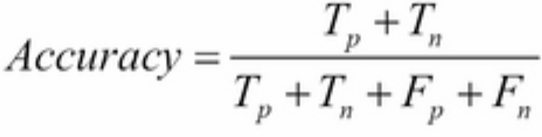
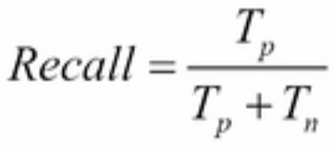
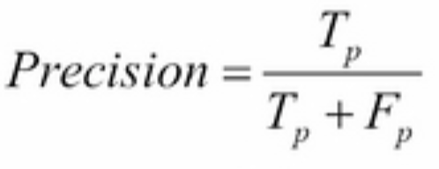
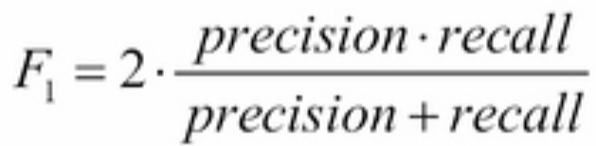
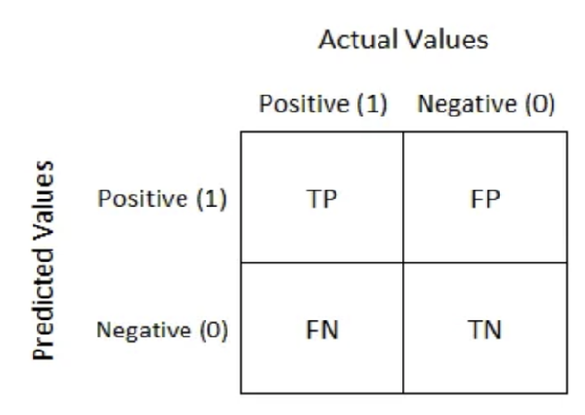
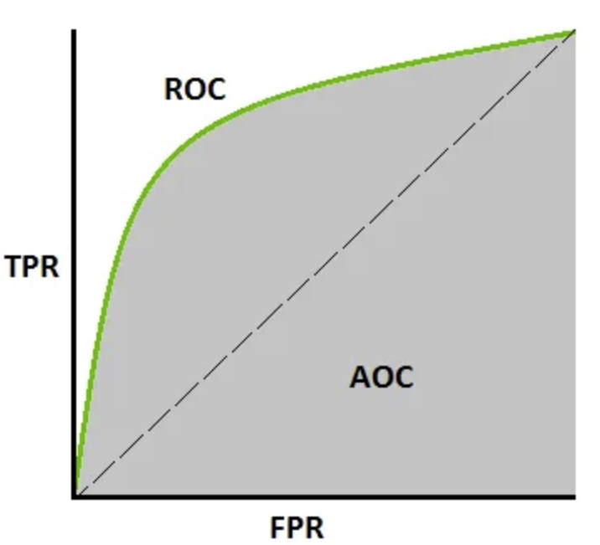
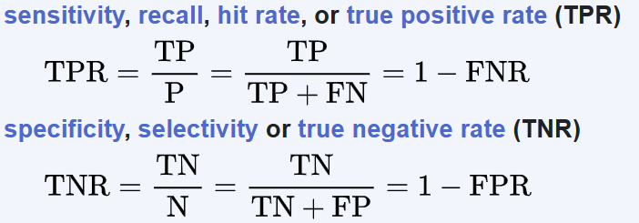
Evaluation: Defect Proneness Prediction
Evaluation: Defect Proneness Prediction | Evaluation: Effort-Aware Defect Prediction
The dependent variable in JIT-SDP is usually defect proneness, the evaluation criteria is usually for binary classification:
Accuracy
Recall
Precision
F-measure (F1 or F2 score)
Confusion matrix
AUC-ROC: Area Under the Receiver Operating Characteristics
Source1: accuracy recall precision f1 score – Bing
Source2: Understanding AUC - ROC Curve | by Sarang Narkhede | Towards Data Science
Source 3: Understanding AUC - ROC Curve | by Sarang Narkhede | Towards Data Science
Source 4: Receiver operating characteristic - Wikipedia

Slide 64
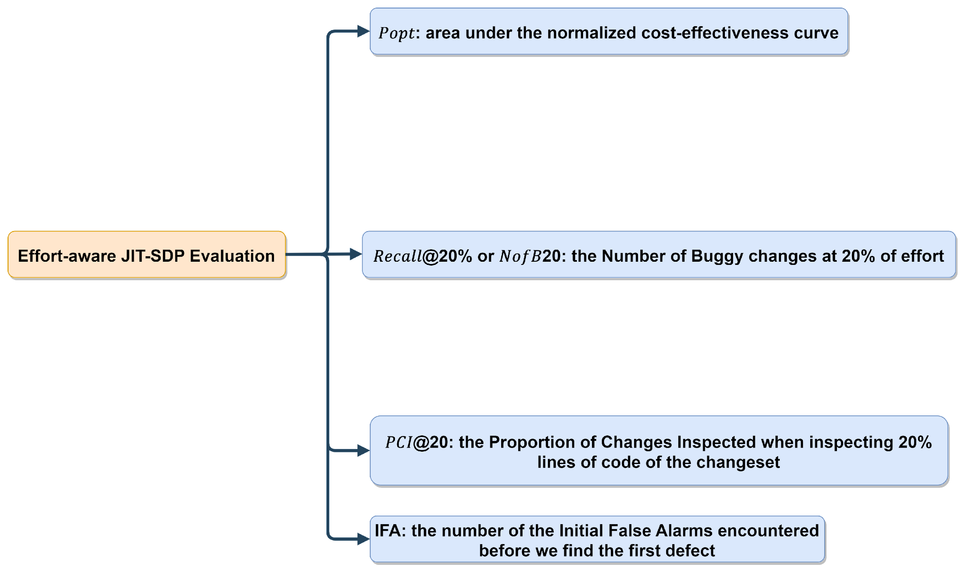
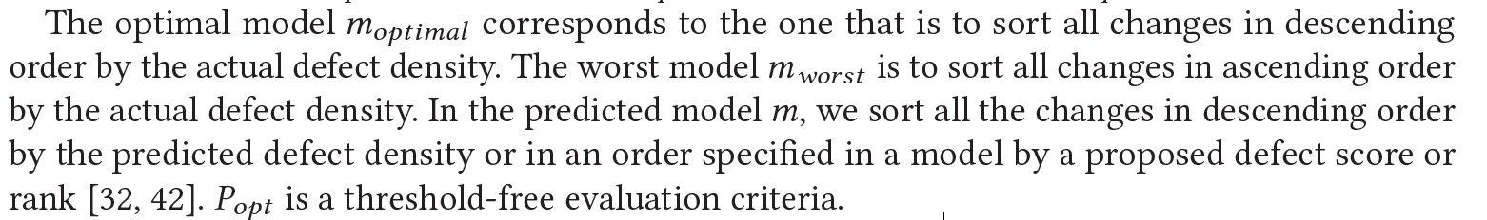
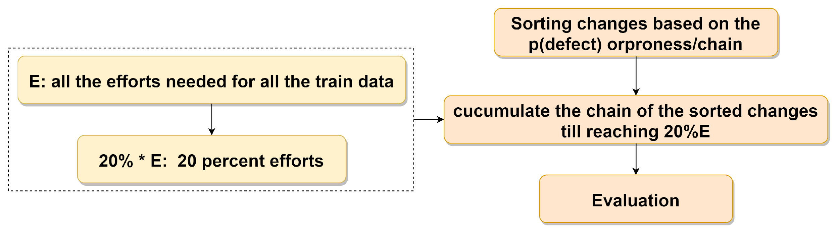
Evaluation: Effort-Aware Defect Prediction
Evaluation: Effort-Aware Defect Prediction | Evaluation: Evaluation Settings

Slide 65
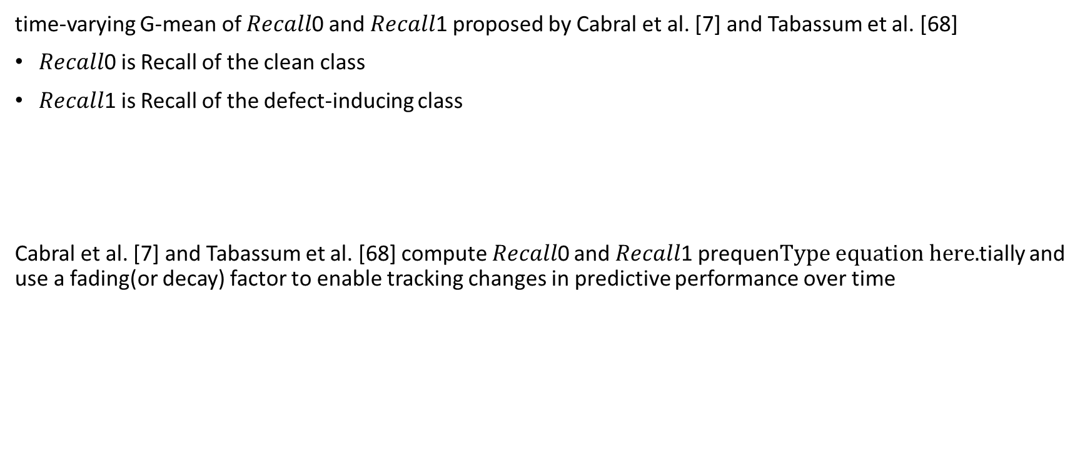
Evaluation: Validation Strategies and Evaluation Settings
Evaluation: Evaluation Settings | Overview: Analysis and Open Questions
Time insensitive:
k-fold cross validation, leave-one-out evaluation, the bootstrap validation
suitable for the batch learning JIT-SDP models
Assumption: data instances are independent Problem: software changes are inter-dependent
Time sensitive
Note: Verification latency and concept drift exist.
Several studies suggest that software projects exhibit temporal variances in their defect characteristics, and recommend evaluations that differentiate a short-period or a long-period prediction in the context of JIT-SDP

Slide 66
Overview
Overview: Analysis and Open Questions | Analysis and Open Questions from the selected papers
Introduction
Paper Selection and Publication Trend
Publication Trend
Overview of JIT-SDP
Review of Just-in-time Software Defect Prediction
Data Sources
Feature Acquisition and Processing
Defect-Inducing Label Assignment
Data Transformation
Modeling
Evaluation
Analysis and Open Questions
Future Research
Conclusion

Slide 67

ANALYSIS AND OPEN QUESTIONS
Analysis and Open Questions from the selected papers | Open Questions

Slide 68



ANALYSIS AND OPEN QUESTIONS
Open Questions | Short names of the studies
How can we continue to improve defect prediction performance?
Need for a standard data set with greater variety of projects.
There are several context factors that have not been reported or explored in JIT-SDP studies

Slide 69

Performance of Defect Proneness Prediction
Short names of the studies | Analysis of Defect Proneness Prediction

Slide 70

Performance of Defect Proneness Prediction
Analysis of Defect Proneness Prediction | Analysis of Effort-Aware Defect Prediction
Ensemble models perform the best at predicting defectiveness of software changes.
However, improvements in predictive performance seem to have plateaued in recent approaches.
How can we continue to improve defect prediction performance?
First, models based on deep learning, e.g., convolutional neural networks, show promising results [24, 25]
Second, researchers are investigating different types of software change metrics and additional sources of data of software changes to help improve predictive performance [40, 74, 75]
Notes:
Figure 3 shows the violin plots of F1 score in the selected JIT-SDP studies; the filled violin plots represent the studies that use the Kamei-2012 data set. For clarity, we sort the filled violin plots by the median F1-scores reported in those studies.
Although 14 studies report F1-scores, we exclude the study by Trautsch et al. [75] from the figure since it only gives a single mean and standard deviation of the 39 projects evaluated, which is not sufficient to produce a violin plot.
Our observations based on Figure 3 are as follows. The study by Zhu et al. [94] appears to be an outlier in that it offers by far the best performance on the Kamei-2012 data set. However, in their study, Zhu et al. [94] show widely improved performance for the baseline as well, indicating that the reported performance may not be comparable.
A method of visualization is violin plots, which illustrate the distribution of the predictive performance. A violin plot is like a box plot that reports summary statistics such as minima, maxima, and median, but is also more informative than a box plot since the violin plot also shows the distribution of the data. The form of the violin plots we render in
this section is as follows.
The left and right contours of a plot exhibit the distribution of the data. The upper and lower limits of the plot show the maximum, and the minimum and the middle bar the average. The upper and lower limits of the filled rectangle inside the plot are the 3rd and 1st quantile while the hollow circle is the median (i.e., the 2nd quantile).

Slide 71

Performance of Effort-Aware Prediction
Analysis of Effort-Aware Defect Prediction | Analysis of Context Factors impact
Ensemble models(TLEL and EATT) are also the best effort-aware models for JIT-SDP.
Searching-based unsupervised
Models(CCUM) yield effort-aware predictive performance similar to the ensemble models, however, they perform much worse on defect predictions than ensembles.
One of the important limitation in prior research in JIT-SDP is the lack of a shared benchmark.
There may be a need for a standard data set with greater variety of projects

Slide 72

Context Factors of Software Project and Changeset Data(1/2)
Analysis of Context Factors impact(1/2) | Analysis of Context Factors impact(2/2)
Context factors presented in prior studies include: the number of commits, the ratio of the defective changes, average change size, average number of developers per modified file, and several others [32].
In most studies, the predictive performance of JIT-SDP positively correlates with the defect ratio of changes in the software project,
i.e., projects with more defects are easier for JIT-SDP to predict defect-inducing changes.
Notes:
The number of changes can be considered as a measure for project maturity for JIT-SDP,
and the ratio of defect-inducing changes as a measure of project
quality.

Slide 73



Analysis of Context Factors impact(2/2) | Overview: Future Research
Context Factors of Software Project and Changeset Data(2/2)
Findings: The predictive performance appears to correlate with the ratio of defect-inducing changes in the software project.
There are several context factors that have not been reported or explored in JIT-SDP studies
For instance:
Which application domain do we obtain better predicative Performance?
Do programming languages matter for JIT-SDP?
Does project maturity impact performance?
Spearman's rank correlation coefficient is a nonparametric measure of rank correlation (statistical dependence between the rankings of two variables.
https://en.wikipedia.org/wiki/Spearman%27s_rank_correlation_coefficient
Notes:
Left figures from different researches which use different datasets, to prove the conclusion

Slide 74
Overview
Overview: Future Research | Future Research Summary
Introduction
Paper Selection and Publication Trend
Publication Trend
Overview of JIT-SDP
Review of Just-in-time Software Defect Prediction
Data Sources
Feature Acquisition and Processing
Defect-Inducing Label Assignment
Data Transformation
Modeling
Evaluation
Analysis and Open Questions
Future Research
Conclusion

Slide 75
Future Research
Future Research Summary | Future Research: Application Domain
Application domain
Relation of defects to software use
Quantifying effort in JIT-SDP
Uncertainty quantification in JIT-SDP
Explainable and actionable defect prediction
Beyond prediction defects

Slide 76
Future Research: Application domain
Future Research: Application Domain | Future Research: Relationship of Defects to Software Use
Several studies have emphasized the importance of application domains of defect prediction models (e.g., is the model used for prioritizing maintenance effort, cost prediction, resource allocation, and reducing technical debt).
For instance,Zeller et al. [88] argue that we should ground SDP in practice, consider what developers think about the models and the results, and how the models and the results help the developers in their daily work.
Wan et al. [76] carry out a study to investigate what practitioners think, behave, and expect when it comes to defect prediction. As a result, they detail a few recommendations. More investigations along this direction would help researches in SDP, including both Release SDP and JIT-SDP, to make SDP easier to adopt, i.e., to improve the quality of developer experience in using SDP.

Slide 77

Future Research: Relationship of Defects to Software Use
Future Research: Relationship of Defects to Software Use | Future Research: Quantifying Effort
Software defects are often the root case of a software failure.
We must pay attention to the relationship of defects (via failures) on software quality,i.e., the impact of the specific defects on the actual reliability of the software.
Notes:
Explain figure b more, process stops earlier or memory enough, called less and so on

Slide 78
Future Research: Quantifying Effort in JIT-SDP
Future Research: Quantifying effort | Future Research: Uncertainty Quantification
Fenton and Neil [16] divide software defects into two broad categories:
requirement defects, i.e., the defects in software requirements, lead to validation failures
design defects, i.e., the defects in design specification, implementation, and maintenance, lead to verification failures
Requirement defects are more costly to fix than design defects, we should reexamine how to quantify effort for effort-aware JIT-SDP.
In effort-aware JIT-SDP, the quality assurance effort is measured as the lines of code reviewed [32].
Future JIT-SDP may consider alternative quality assurance effort measures, such as, by differentiating the efforts to address validation failures and those to address verification failures.
For instance, researchers can attempt to use traceability analysis approaches that link “high-level” artifacts, e.g., requirements, to “low-level”, e.g., software code [50]. As another alternative, several studies examine software faults and failure types and their occurrences in different phases of software development life cycle processes [22].

Slide 79
Future Research: Uncertainty Quantification in JIT-SDP
Future Research: Uncertainty Quantification | Future Research: Explainable and Actionable
Types of uncertain quality:
Concept drift
Unreliable SZZ
A direction of research we propose is to quantify these different types of uncertainties in JIT-SDP
and use them to convey the magnitude of uncertainty to JIT-SDP users.
Topic | Note
Data Quality(7) | 3 papers talking about SZZ, 1 paper builds a large dataset, 2 papers are about the bug including commit detection and fix inducing identification

Slide 80
Future Research: Explainable and Actionable Defect Prediction
Future Research: Explainable and Actionable | Future Research: Beyond Predicting Defects
How do we make our defect prediction results actionable?
It begins with making the prediction results explainable [34]. One approach is to link the prediction results with context factors of the data sets. Hall et al. [21] note that without the context factors of the data sets it becomes difficult to understand the implications of SDP models and results. Recent JIT-SDP studies have included some context factors, however, software projects have diverse context factors and it remains unclear what context factors best characterize a software project [90].
There is a need to continue exploring project context factors and software metrics, and their relationship with defection prediction results.
how can we make a complex JIT-SDP model explainable?
DL models often take an “end-to-end” approach, e.g., in the context of JIT-SDP, taking directly software changes and commit messages as the input and predict defect prone changes. Xie et al. [77] provide an overview about building explainable deep learning models. Leveraging this research and alike, future research directions may include the design of explainable deep neural network models for JIT-SDP.
Zeller et al. [88] have cautioned us, i.e., “being nonactionable may still be better than suggesting the wrong actions” and argue that we should be careful when using complexity metrics or overly simple features in defect prediction since we may more easily arrive at suggesting wrong actions. Similar in spirit, we should also caution about complex models.

Slide 81
Future Research: Beyond Predicting Defects
Future Research: Beyond Predicting Defects | Future Research: Research since Dec 2021
Specific detects(4) | Vulnerability, security, dormant
Domain combination(3) | Localization, defect type prediction
Programming language specific(2) | Features or models on specific programming language projects

Slide 82
Future Research: Research since Dec 2021 | Overview: Conclusion
Researches since Dec 2021
# of papers from libraries | # of papers from snowballing | # of papers
19 | 2 | 21
Topic | Note
Data Quality(7) | 3 papers talking about SZZ, 1 paper builds a large dataset, 2 papers are about the bug including commit detection and fix inducing identification
Programming language specific(2) | Features or models on specific programming language projects
Features | 2 papers are with new code features(specific language feature and code representative)
Explainable (2)
Cross-project(2)
Specific detects(4) | Vulnerability, security, dormant
Domain combination(3) | Localization, defect type prediction
effort-aware, evaluation(1)
Models(3) | Ensemble, DL

Slide 83
Overview
Introduction
Paper Selection and Publication Trend
Publication Trend
Overview of JIT-SDP
Review of Just-in-time Software Defect Prediction
Data Sources
Feature Acquisition and Processing
Defect-Inducing Label Assignment
Data Transformation
Modeling
Evaluation
Analysis and Open Questions
Future Research
Conclusion

Slide 84

Conclusion
With the aim at understanding the state-of-the-art of the JIT-SDP models’ performance, we conduct a meta-analysis of existing studies.
In our literature survey, we discuss the major achievement of JIT-SDP research in context of the entire workflow of JIT-SDP, point out the questions in this area and provide the possible future research directions.

Slide 85
Conclusion
PUBLICATIONS
1. Yunhua Zhao, Kostadin Damevski, and Hui Chen. A systematic survey of just-in-time software defect prediction. ACM Computing Surveys, 55(10):1–35, 2023
2. Yunhua Zhao and Hui Chen. 2023. Deep Incremental Learning of Imbalanced Data for Just-In-Time Software Defect Prediction. TR-2022-128. IEEE Transactions on Reliability. (Major Revision)
3. Hui Chen, Ashfin Enayet, Yunhua Zhao, kostadin Damevski. Quantifying the Uncertainty in Software Vulnerability Patch Data. International Conference on Software Engineering (ICSE 2024).(Submitted)
Current Research:
Build more explanable models, using reinforcement learning to build a more explanable model with self learning ability
Notes:
The first paper is to understand the research area
The second paper, we proposed the online learning model to address the concept drift problem based on the findings of the survey, and keep the iner relationship of changes, at the same time we proposed a class imbalancing method which maintains the closet data distribution as the original data
The third paper is about a specific defect type, vulnerable defect prediction
Now I am working on the explainable model with reinforcement learning, which could learn from experience and adapt to the little start data charactor

Slide 86




Thank you
Paper link: https://dl.acm.org/doi/abs/10.1145/3567550
Paper github: https://github.com/huichen-cs/deepicpreplication
Online Supplement: https://github.com/huichen-cs/jitsdpsurvey
Email: yzhao5@gradcenter.cuny.edu

